Slide 1
UBICHARGE
TalTech is looking for a CEO and co-founder for a new potential startup
Preferred background of the CEO: business development in the field of power electronics.

Slide 2
Opportunity and conditions
TalTech annual budget for RD activites is 50M euros.
In order to take research to the market we need multifaceted great teams and therefore we are looking for a CEOs for science based tech startups.
What you get: equity in the company which is based on years of research. Cap Table will be decided together with research partners. TalTech will get equity in the founding stage in the range of 5-10% for exchange of IP.
What we expect from the cofounder:
- describe the best possible product market fit
- personal contribution (time and/or money)
- capability to attract funding (personal and/or investors/grants)
In order to apply for the cofounder position, finish the slides (feel free to add/modify slides) and return them to mirjam.kert@taltech.ee by 12.Feb 2026
In case current team members see you fit to be the potential CEO we will arrange a meeting and discuss potential co-founding possibility.
Questions: mirjam.kert@taltech.ee

Slide 3
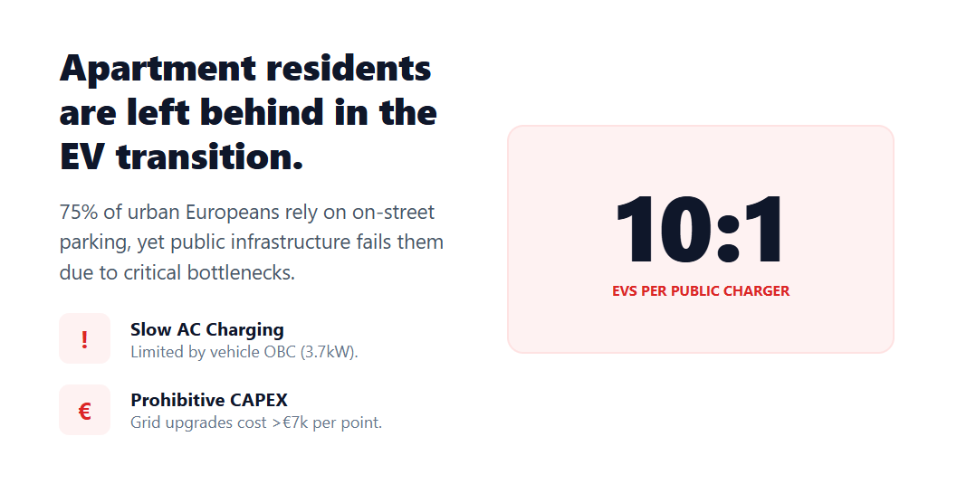
PROBLEM

Slide 4
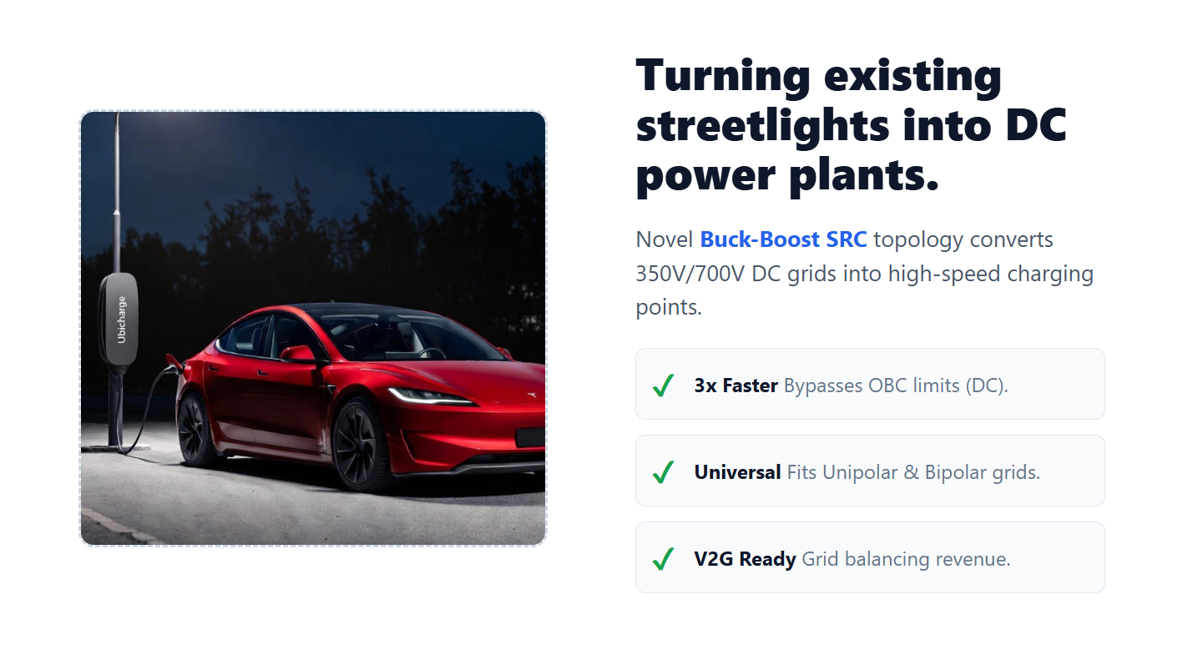
SOLUTION

Slide 5
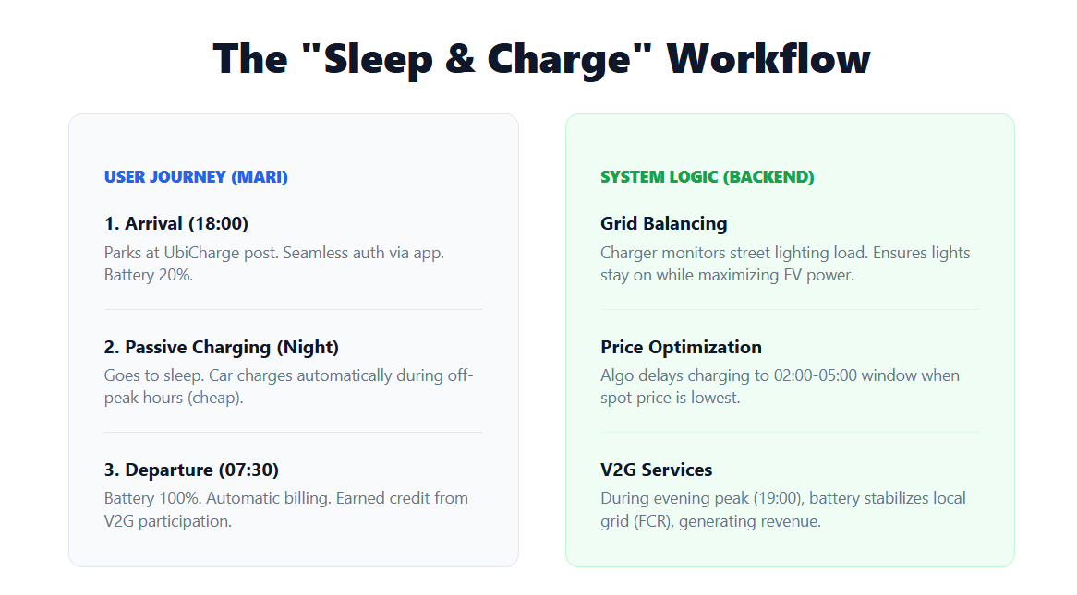
USECASE

Slide 6
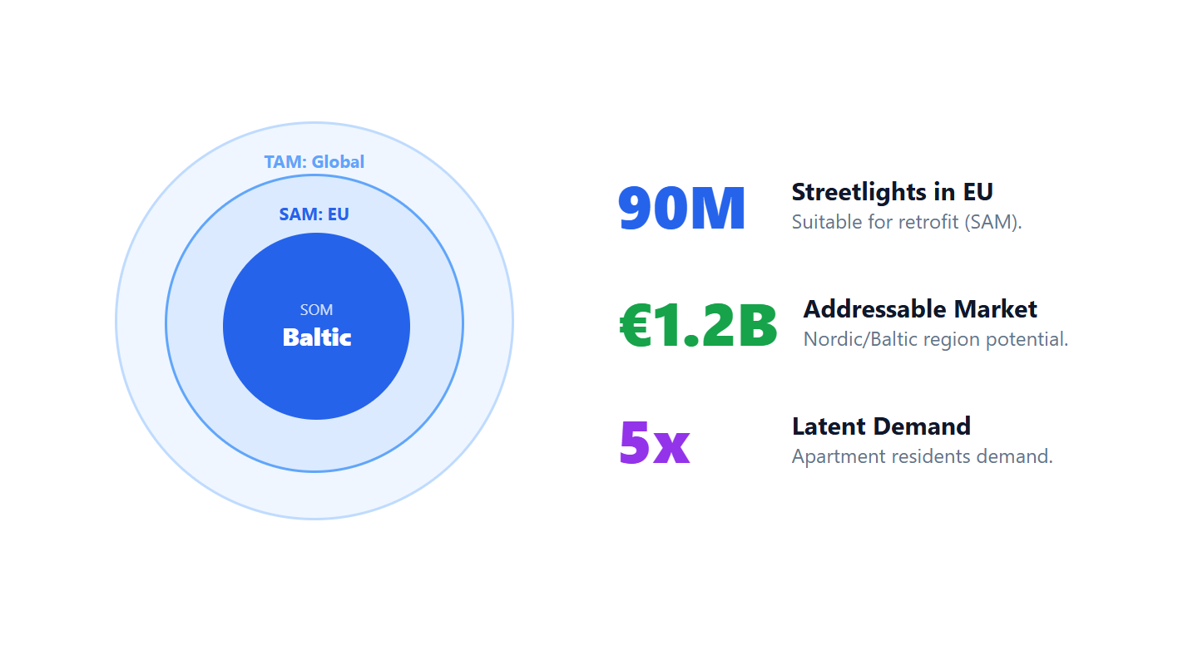
MARKET OPPORTUNITY

Slide 7
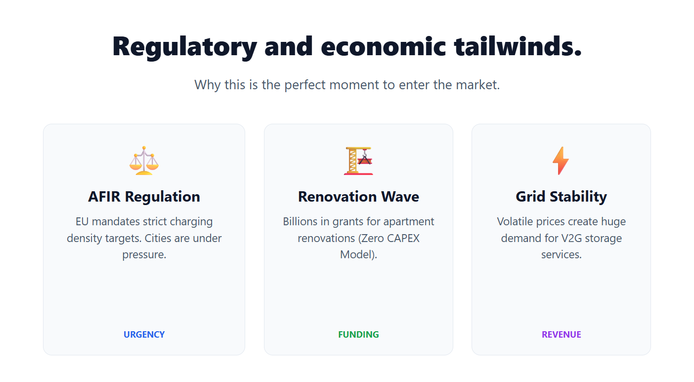
MARKET OPPORTUNITY

Slide 8
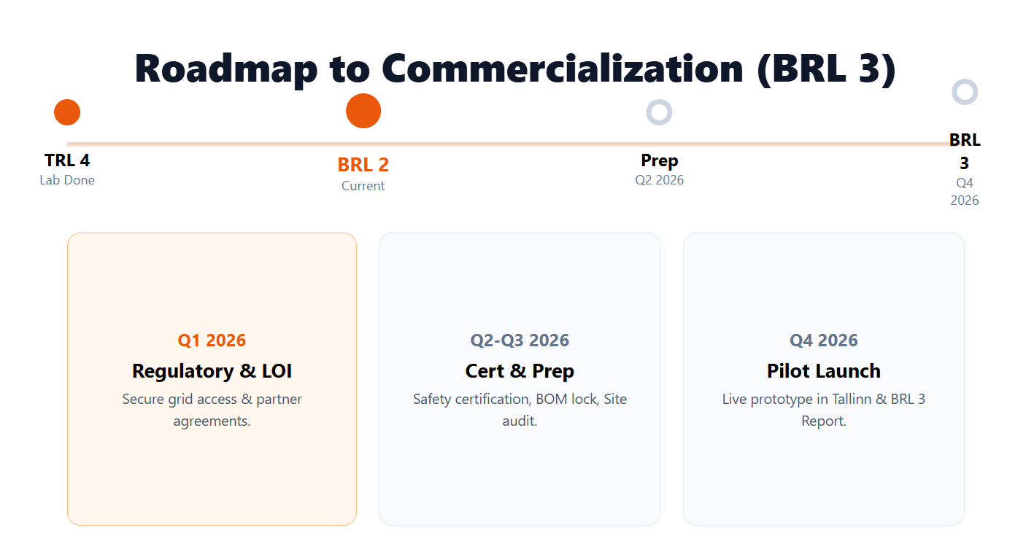
CURRENT STATE

Slide 9
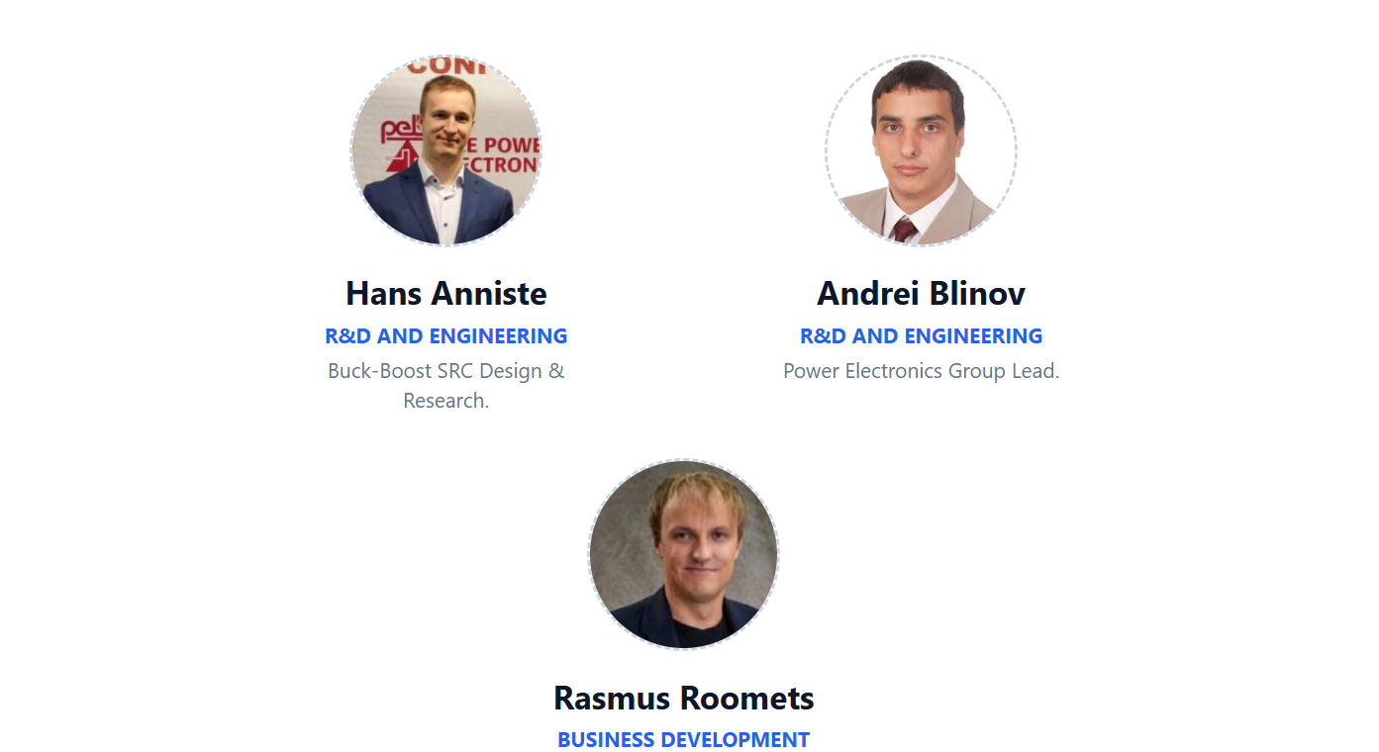
TEAM

Slide 10
UBICHARGE
XXXX XXXXXXX, potential CEO and CoFounder
LinkedIn: link

Slide 11

MARKET OPPORTUNITY (TAM, SAM, SOM)
INPUT BY POTENTIAL CEO
---

Slide 12
COMMERCIALIZATION PLAN
FROM LAB TO PRODUCT
INPUT BY POTENTIAL CEO
---

Slide 13
FINANCIAL PROJECTIONS:
PATH TO MAXIMIZE STARTUP VALUE
INPUT BY POTENTIAL CEO
---

Slide 14
VISION FOR FUTURE TEAM
INPUT BY POTENTIAL CEO
---

Slide 15
CONTRIBUTION
(TalTech will give options shares for the new co-founder, what is that you are willing to invest in terms of money, time and competencies and what are your expectations regarding option shares)
INPUT BY POTENTIAL CEO
I'm suitable to be the founding member ...
My contribution can be (time, money, competencies, contacts etc)
My expectations regarding option shares in startup founding stage is in the range of x-x%

