Slide 1
IOCBIO Gel
TalTech is looking for a CEO and co-founder for a new potential startup
Preferred background of the CEO: business development in the field of biotechnology.
Software for biolaboratories

Slide 2
Opportunity and conditions
TalTech annual budget for RD activites is 50M euros.
In order to take research to the market we need multifaceted great teams and therefore we are looking for a CEOs for science based tech startups.
What you get: equity in the company which is based on years of research. Cap Table will be decided together with research partners. TalTech will get equity in the founding stage in the range of 5-10% for exchange of IP.
What we expect from the cofounder:
- describe the best possible product market fit
- personal contribution (time and/or money)
- capability to attract funding (personal and/or investors/grants)
In order to apply for the cofounder position, finish the slides (feel free to add/modify slides) and return them to mirjam.kert@taltech.ee
In case current team members see you fit to be the potential CEO we will arrange a meeting and discuss potential co-founding possibility.
Questions: mirjam.kert@taltech.ee

Slide 3
PROBLEM
There is no software available for 100+K biolabs for efficient, metadata based and backtraceable lab work involving Western Blot and similar analysis
Lack of efficiency is lost time and cost
Metadata and backtracing reduces labs credibility and scientific output
There is no user friendly software for biologists
There is no hosted service for biology labs
Open-source/free landscape offers basic tools (ImageJ, GelAnalyzer,LabImage), whereas commercial vendors offer more polished, often hardware-tied solutions. Most free tools lack integrated metadata management or audit trails.

Slide 4
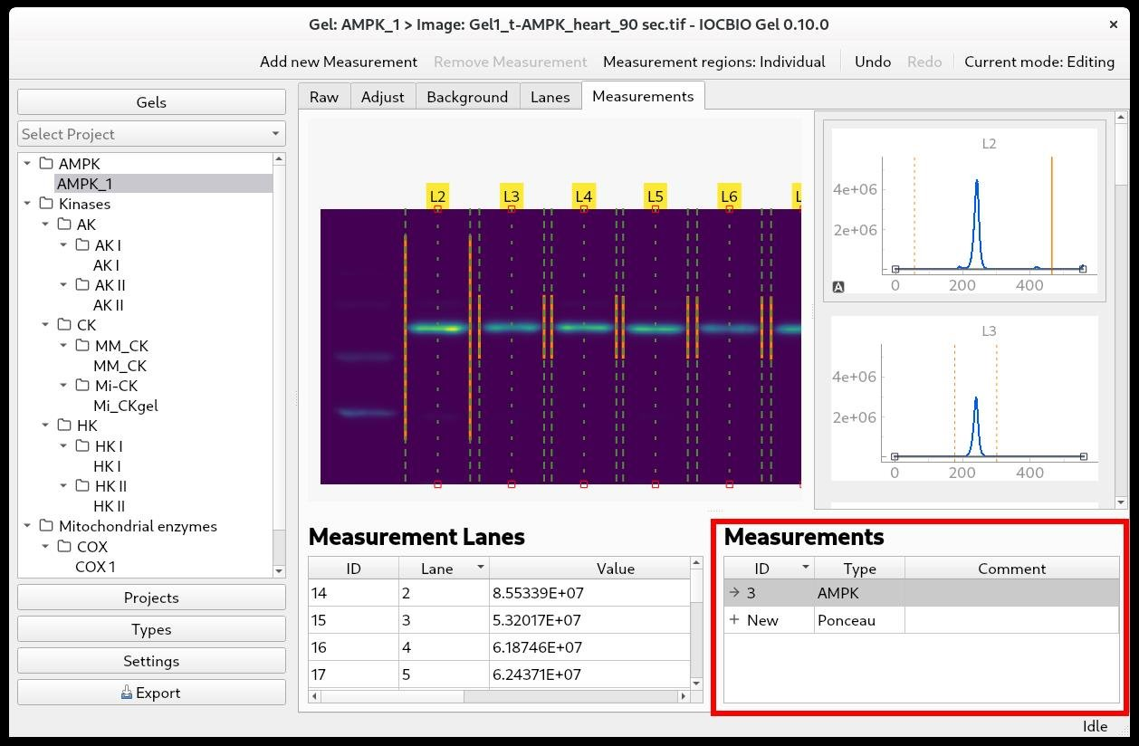
SOLUTION
User friendly time and cost saving metadata based backtraceable software
IOCBIO Gel’s unique aspect is its central database (PostgreSQL)and image repository (using OMERO).
We provide labs with a hosted service: secure servers storing raw images and metadata, accessible by all researchers.

Slide 5
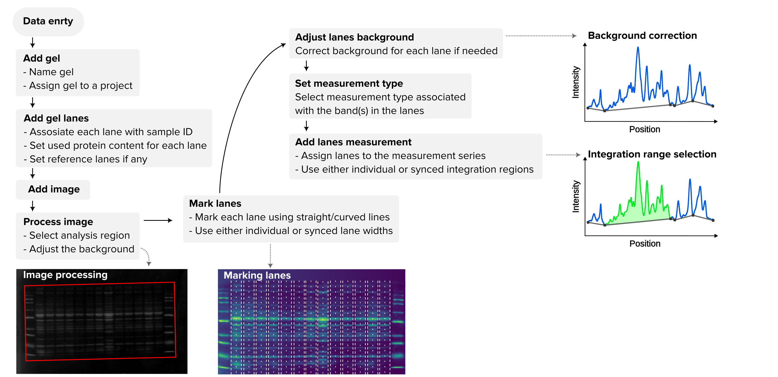
USECASE

Slide 6
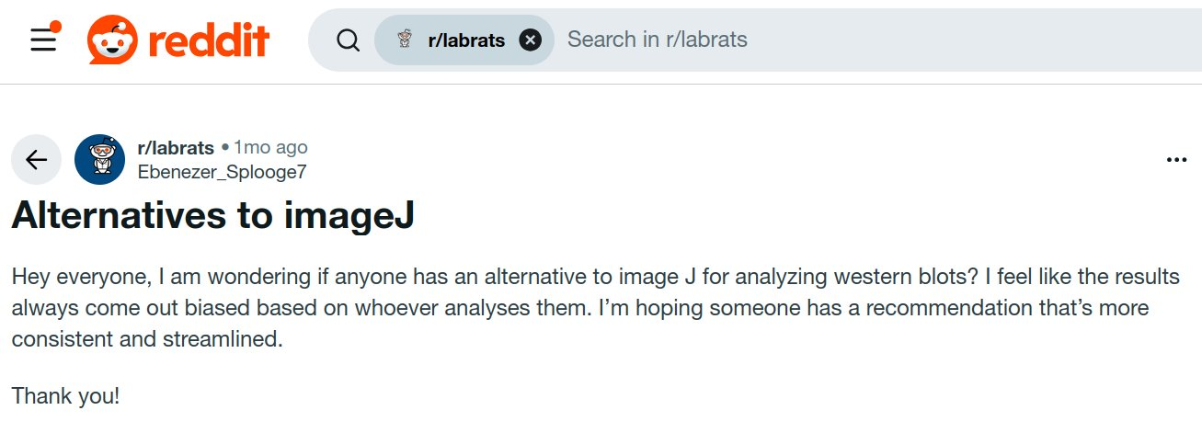
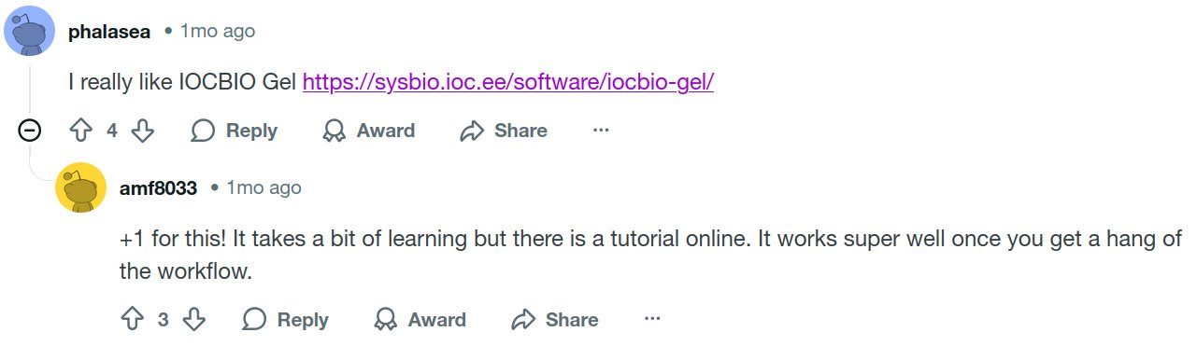
MARKET OPPORTUNITY
Commercial Software Competitors:
Many instrument manufacturers provide integrated or stand‑alone Western blot analysis software
(often free with their hardware), and a few independent companies sell specialized gel analysis packages
Thermo Fisher (iBright)
Bio-Rad Laboratories
Open-Source Competitors:
ImageJ/Fiji (Gel Analyzer plugin)
GelAnalyzer
LabImage 1D (free edition)
GelGenie – prototype that can be used to train AI model
In summary, the open-source/free landscape offers basic tools (ImageJ, GelAnalyzer,LabImage) and our IOCBIO Gel, whereas commercial vendors offer more polished, often hardware-tied solutions. Most free tools lack integrated metadata management or audit trails.

Slide 7
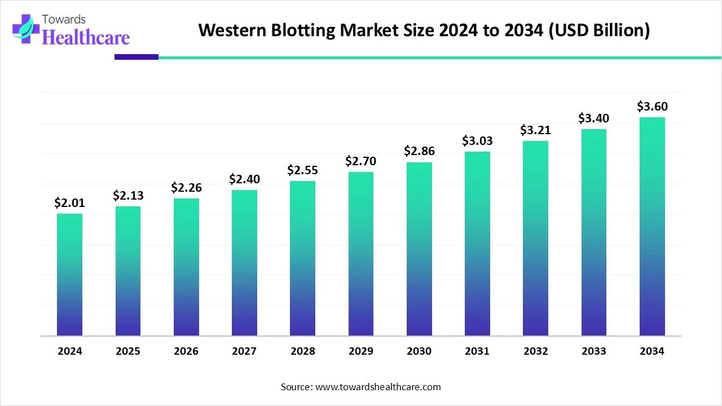
MARKET OPPORTUNITY
Recent reports estimate Western blotting market at ~US$2.0 billion in 2024 (instruments and consumables) and projecting ~US$3.6 billion by 2034

Slide 8
CURRENT STATE
MVP ready and usable
Future developmens needed:
Central service
AI lane detection (work in progress)
Industry standards
Data analysis: statistics and graphs

Slide 9
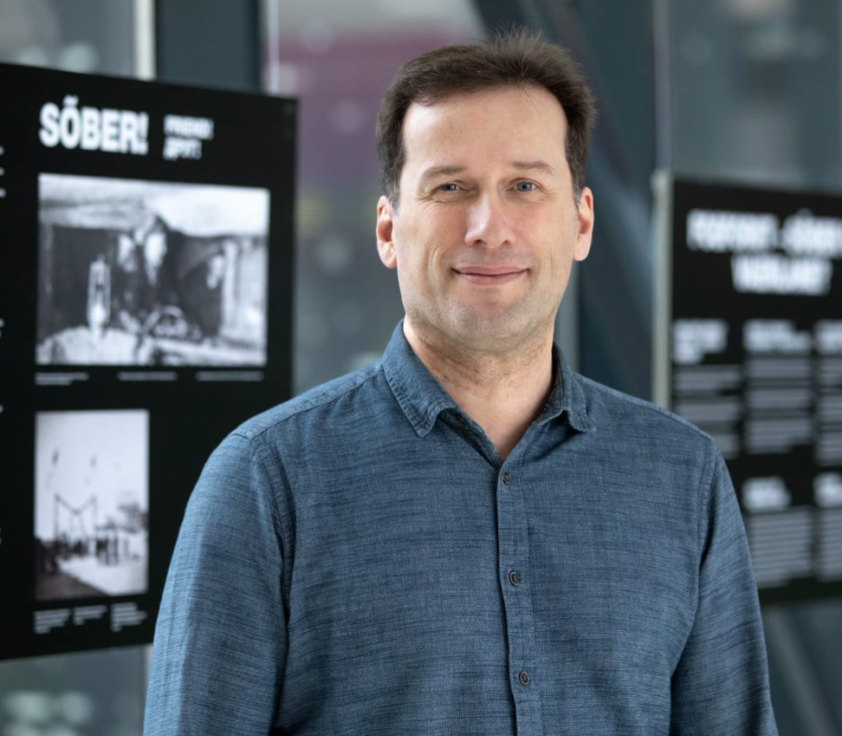
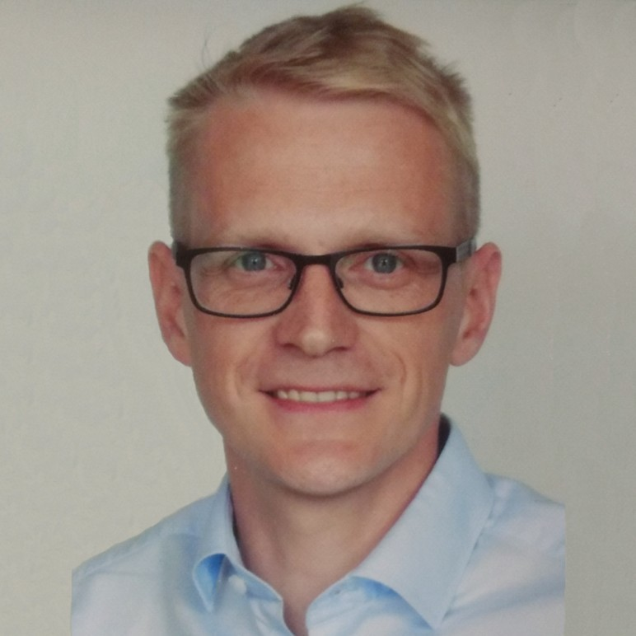
Team
Current Team
Top research talent from Systems Biology Lab
Professor Marko Vendelin -
https://www.etis.ee/CV/Marko_Vendelin/eng/
Assistant Professor Martin Laasmaa -
https://www.linkedin.com/in/martin-laasmaa-68a883150/
https://www.etis.ee/CV/Martin_Laasmaa/eng/
Years of extensive lab work optimization
Top research in the field
Softwared development
Future Potential Team competencies and background
In additon to current team:
Business development and sales in biotech
Strong contacts base with biolabs
Industry proven software development
Data security

Slide 10
IOCBIO Gel
XXXX XXXXXXX, potential CEO and CoFounder
LinkedIn: link

Slide 11

MARKET OPPORTUNITY (TAM, SAM, SOM)
INPUT BY POTENTIAL CEO
---

Slide 12
COMMERCIALIZATION PLAN
FROM LAB TO PRODUCT
INPUT BY POTENTIAL CEO
---

Slide 13
FINANCIAL PROJECTIONS:
PATH TO MAXIMIZE STARTUP VALUE
INPUT BY POTENTIAL CEO
---

Slide 14
VISION FOR FUTURE TEAM
INPUT BY POTENTIAL CEO
---

Slide 15
CONTRIBUTION
(TalTech will give options shares for the new co-founder, what is that you are willing to invest in terms of money, time and competencies and what are your expectations regarding option shares)
INPUT BY POTENTIAL CEO
I'm suitable to be the founding member ...
My contribution can be (time, money, competencies, contacts etc)
My expectations regarding option shares in startup founding stage is in the range of x-x%

