Slide 1
LignoLight UV-Protective and Antimicrobial Additive
TalTech is looking for a CEO and co-founder for a new potential startup
Preferred background of the CEO: business development in the field of wood chemistry, cosmetics.

Slide 2
Opportunity and conditions
TalTech annual budget for RD activites is 50M euros.
In order to take research to the market we need multifaceted great teams and therefore we are looking for a CEOs for science based tech startups.
What you get: equity in the company which is based on years of research. Cap Table will be decided together with research partners. TalTech will get equity in the founding stage in the range of 5-10% for exchange of IP.
What we expect from the cofounder:
- describe the best possible product market fit
- personal contribution (time and/or money)
- capability to attract funding (personal and/or investors/grants)
In order to apply for the cofounder position, finish the slides (feel free to add/modify slides) and return them to mirjam.kert@taltech.ee
In case current team members see you fit to be the potential CEO we will arrange a meeting and discuss potential co-founding possibility.
Questions: mirjam.kert@taltech.ee

Slide 3
PROBLEM
INPUT FROM TALTECH
UV-Protective and Antimicrobial Additives Are Toxic and Petrochemical-Based
Today’s UV filters and antimicrobial agents are petrochemical-based, toxic, and increasingly regulated.
Brands in packaging, cosmetics, and consumer goods face pressure to eliminate harmful chemicals from products.
Existing alternatives are expensive to produce and difficult to integrate into modern polymer and coating systems.
This creates a growing market gap for bio-based, cost-effective, high-performance UV protection.

Slide 4
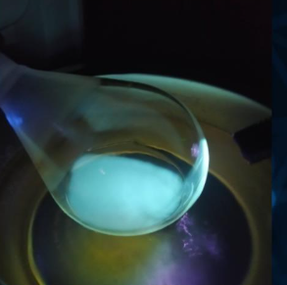
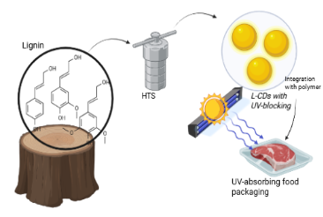

SOLUTION
INPUT FROM TALTECH
LignoLight - High-Value Carbon Dot Additives From Lignin Waste Streams
Converts low-value biomass lignin into functional carbon dots (L-CDs) with strong UV-blocking and antibacterial properties.
Offers a non-toxic, biodegradable, bio-based alternative to petrochemical UV filters and antimicrobial additives.
Cost advantage: innovative dialysis-based process eliminates the need for expensive chromatographic purification.
Easily integrated into packaging films, cosmetics, coatings, and optical materials, enabling longer shelf life for UV-sensitive products.

Slide 5
CURRENT STATE
INPUT FROM TALTECH
TRL3 Validated Technology With Clear Commercial Upside
Lab validation confirms strong UV absorption, broad antibacterial efficacy, and non-toxic profile.
Demonstrated compatibility with transparent polymer films for smart packaging prototypes.
Technology is scalable and cost-efficient, ideal for high-volume industries seeking sustainable materials.
Strong scientific team advancing material integration and scale-up.
Next milestones: industry pilots, applied prototype testing, and commercialization partnerships.

Slide 6
MARKET OPPORTUNITY
INPUT FROM TALTECH
UV protection today comes mainly from petrochemical additives supplied by large players like BASF, Clariant, Solvay.
These solutions work, but face regulatory pressure and sustainability concerns.
Bio-based UV additives exist, but are often limited in performance or scale.
LignoLight offers a bio-based alternative that behaves like a real industrial additive, not a niche product.
The opportunity is to sell as an ingredient to packaging, coatings or cosmetics manufacturers.

Slide 7
LIGNOLIGHT
XXXX XXXXXXX, potential CEO and CoFounder
LinkedIn: link

Slide 8
MARKET OPPORTUNITY (TAM, SAM, SOM)
INPUT BY POTENTIAL CEO
---

Slide 9
COMMERCIALIZATION PLAN
FROM LAB TO PRODUCT
INPUT BY POTENTIAL CEO
---

Slide 10
FINANCIAL PROJECTIONS:
PATH TO MAXIMIZE STARTUP VALUE
INPUT BY POTENTIAL CEO
---

Slide 11
VISION FOR FUTURE TEAM
INPUT BY POTENTIAL CEO
---

Slide 12
CONTRIBUTION
(TalTech will give options shares for the new co-founder, what is that you are willing to invest in terms of money, time and competencies and what are your expectations regarding option shares)
INPUT BY POTENTIAL CEO
I'm suitable to be the founding member ...
My contribution can be (time, money, competencies, contacts etc)
My expectations regarding option shares in startup founding stage is in the range of x-x%

