Slide 1
LignoPrint
TalTech is looking for a CEO and co-founder for a new potential startup
Preferred background of the CEO: business development in the field of wood chemistry, 3D-printing materials.

Slide 2
Opportunity and conditions
TalTech annual budget for RD activites is 50M euros.
In order to take research to the market we need multifaceted great teams and therefore we are looking for a CEOs for science based tech startups.
What you get: equity in the company which is based on years of research. Cap Table will be decided together with research partners. TalTech will get equity in the founding stage in the range of 5-10% for exchange of IP.
What we expect from the cofounder:
- describe the best possible product market fit
- personal contribution (time and/or money)
- capability to attract funding (personal and/or investors/grants)
In order to apply for the cofounder position, finish the slides (feel free to add/modify slides) and return them to mirjam.kert@taltech.ee
In case current team members see you fit to be the potential CEO we will arrange a meeting and discuss potential co-founding possibility.
Questions: mirjam.kert@taltech.ee

Slide 3
PROBLEM
INPUT FROM TALTECH
3D Printing Filaments Are Costly, Petrochemical-Based, and Performance-Limited
Standard PLA is expensive to produce and sensitive to heat, limiting its use in demanding applications.
Manufacturers lack sustainable, high-performance alternatives that meet growing green-material regulations.
Existing bio-based filaments struggle with poor mechanical properties and compatibility issues.
Industry needs materials that are cheaper, stronger, and more sustainable without sacrificing printability.

Slide 4
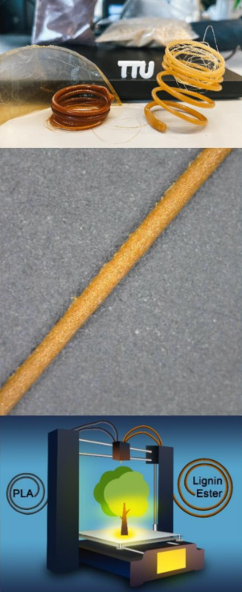

SOLUTION
INPUT FROM TALTECH
LignoPrint - High-Performance, Cost-Effective Filaments With Up to 30% Lignin
Breakthrough material combining PLA with up to 30% lignin, a dramatically higher loading than conventional approaches.
Proprietary chemical functionalization improves compatibility, printability, and mechanical strength.
Results in filaments with enhanced thermal stability (higher Tg) and tunable mechanical properties for different use-cases.
Delivers a sustainable, biodegradable, and cost-efficient alternative to traditional PLA, ideal for eco-conscious manufacturing.

Slide 5
CURRENT STATE
INPUT FROM TALTECH
TRL 4 and Strong Commercial Potential
Six optimized chemical modification pathways validated, integration techniques proven at lab scale.
Demonstrated improvements in thermal performance, mechanical properties, and long-term stability.
Clear scalability potential for industrial production of high-performance, green 3D printing materials.
Supported by strong TalTech R&D team, next steps include pilot-scale filament production and industry partnerships for adoption.

Slide 6
MARKET OPPORTUNITY
INPUT FROM TALTECH
Most users today buy filaments from brands like Polymaker, Prusament, BASF, NatureWorks (PLA).
Sustainable filaments exist, but are often more expensive or harder to print.
Many customers want greener materials but won’t change printers or processes.
LignoPrint fits into existing workflows while improving sustainability and potentially cost.
This creates an entry point via distributors, education, and industrial prototyping users.

Slide 7
MARKET OPPORTUNITY
(TAM, SAM, SOM)
INPUT BY POTENTIAL CEO
---

Slide 8
COMMERCIALIZATION PLAN
FROM LAB TO PRODUCT
INPUT BY POTENTIAL CEO
---

Slide 9
FINANCIAL PROJECTIONS:
PATH TO MAXIMIZE STARTUP VALUE
INPUT BY POTENTIAL CEO
---

Slide 10
VISION FOR FUTURE TEAM
INPUT BY POTENTIAL CEO
---

Slide 11
CONTRIBUTION
(TalTech will give options shares for the new co-founder, what is that you are willing to invest in terms of money, time and competencies and what are your expectations regarding option shares)
INPUT BY POTENTIAL CEO
I'm suitable to be the founding member ...
My contribution can be (time, money, competencies, contacts etc)
My expectations regarding option shares in startup founding stage is in the range of x-x%

