Slide 1
3D-Optimized Magnetic Cores
TalTech is looking for a CEO and co-founder for a new potential startup
Preferred background of the CEO: business development in the field of electromechanical engineering, automotive.

Slide 2
Opportunity and conditions
TalTech annual budget for RD activites is 50M euros.
In order to take research to the market we need multifaceted great teams and therefore we are looking for a CEOs for science based tech startups.
What you get: equity in the company which is based on years of research. Cap Table will be decided together with research partners. TalTech will get equity in the founding stage in the range of 5-10% for exchange of IP.
What we expect from the cofounder:
- describe the best possible product market fit
- personal contribution (time and/or money)
- capability to attract funding (personal and/or investors/grants)
In order to apply for the cofounder position, finish the slides (feel free to add/modify slides) and return them to mirjam.kert@taltech.ee
In case current team members see you fit to be the potential CEO we will arrange a meeting and discuss potential co-founding possibility.
Questions: mirjam.kert@taltech.ee

Slide 3
PROBLEM
INPUT FROM TALTECH
Electric motors are heavy, inefficient and constrained by outdated manufacturing limits
Traditional electromagnetic components (wound stators, fixed-shape cores, straight airgaps) limit torque density and energy efficiency.
Motor manufacturers cannot fully optimize geometry because conventional production methods cannot realize complex 3D shapes.
The result: excess weight, high production cost, thermal losses and lower performance, especially in mobility, robotics and aerospace sectors.
The industry urgently needs lighter, more powerful and additively manufacturable motor components.

Slide 4
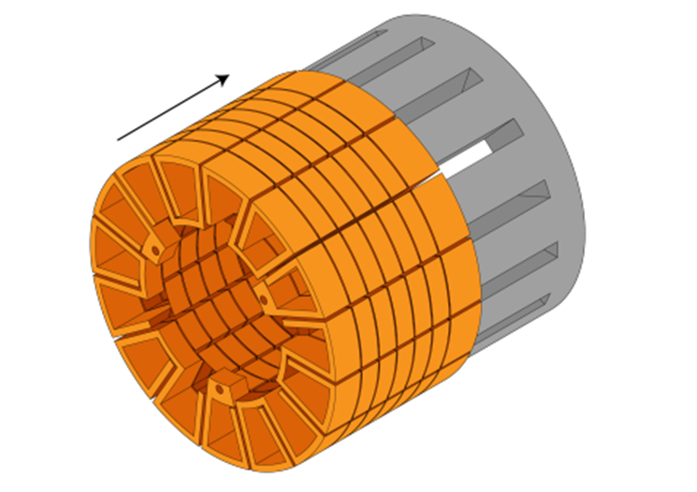
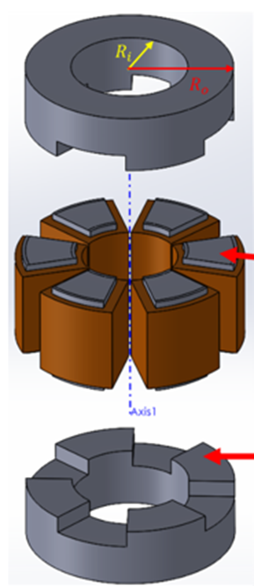
SOLUTION
3D-printed, analytically optimized electromagnetic components that dramatically boost motor performance
Novel curved-airgap magnetic topology increases effective airgap area and flux linkage, enabling significant torque and efficiency gains without increasing motor size.
Research shows up to +25% torque, +18% torque density, and +8% efficiency improvement at optimal curvature.
Monolithic 3D-printed windings unlock higher power density and cooling capacity compared to conventional wound coils.
Delivers lighter, more efficient, AM-ready electric machines for next-generation mobility, aerospace, drones and robotics.

Slide 5
CURRENT STATE
INPUT FROM TALTECH
TRL 4 patented technology with commercial traction and growing IP portfolio
Core concepts validated via simulation and lab testing; up to 24.7% torque increase demonstrated in research
2 patent applications (EU + US) and 3 new inventions pending.
Strong external interest: discussions with supercar manufacturers (Koenigsegg) and major US drone producers.

Slide 6

MARKET OPPORTUNITY
INPUT FROM TALTECH
Electric motor manufacturers today rely on standard magnetic cores from established suppliers or in-house designs.
Performance improvements usually mean long development cycles or full motor redesigns, which OEMs avoid if possible.
Alternatives are incremental material tweaks or switching suppliers, not real geometry optimization.
MagCore offers a way to improve performance within existing motor concepts, making adoption more realistic.
The opportunity is to work with OEMs, Tier-1 suppliers or niche high-performance manufacturers.

Slide 7
MARKET OPPORTUNITY (TAM, SAM, SOM)
INPUT BY POTENTIAL CEO
---

Slide 8
COMMERCIALIZATION PLAN
FROM LAB TO PRODUCT
INPUT BY POTENTIAL CEO
---

Slide 9
FINANCIAL PROJECTIONS:
PATH TO MAXIMIZE STARTUP VALUE
INPUT BY POTENTIAL CEO
---

Slide 10
VISION FOR FUTURE TEAM
INPUT BY POTENTIAL CEO
---

Slide 11
CONTRIBUTION
(TalTech will give options shares for the new co-founder, what is that you are willing to invest in terms of money, time and competencies and what are your expectations regarding option shares)
INPUT BY POTENTIAL CEO
I'm suitable to be the founding member ...
My contribution can be (time, money, competencies, contacts etc)
My expectations regarding option shares in startup founding stage is in the range of x-x%

