Slide 1
TarkBox Smart Waste Monitoring System for Smarter Cities
TalTech is looking for a CEO and co-founder for a new potential startup
Preferred background of the CEO: business development in the field of smart waste IoT.

Slide 2
Opportunity and conditions
TalTech annual budget for RD activites is 50M euros.
In order to take research to the market we need multifaceted great teams and therefore we are looking for a CEOs for science based tech startups.
What you get: equity in the company which is based on years of research. Cap Table will be decided together with research partners. TalTech will get equity in the founding stage in the range of 5-10% for exchange of IP.
What we expect from the cofounder:
- describe the best possible product market fit
- personal contribution (time and/or money)
- capability to attract funding (personal and/or investors/grants)
In order to apply for the cofounder position, finish the slides (feel free to add/modify slides) and return them to mirjam.kert@taltech.ee
In case current team members see you fit to be the potential CEO we will arrange a meeting and discuss potential co-founding possibility.
Questions: mirjam.kert@taltech.ee

Slide 3
PROBLEM
INPUT FROM TALTECH
Inefficient and costly waste collection due to lack of real-time visibility
Waste collection is still schedule-based, not demand-based.
Lack of real-time container data leads to unnecessary trips and higher costs.
Overflowing containers create hygiene and safety issues for cities and residents.

Slide 4
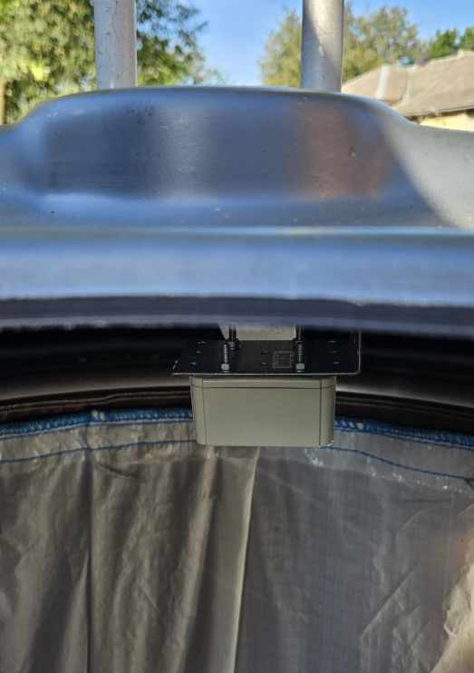

SOLUTION
INPUT FROM TALTECH
TarkBox – Smart IoT-based Waste Monitoring & Optimization System
IoT sensors + cloud platform for real-time monitoring of underground containers.
Optimizes routes and enables demand-based waste collection.
Reduces costs, emissions, and hygiene risks; scalable for cities and private operators.

Slide 5
CURRENT STATE
INPUT FROM TALTECH
TRL 7 – tested and validated in real-world environment
Co-developed by TalTech ViDRIK, Telia, Kohtla-Järve.
Demo available. Ready for market validation and commercial rollout.
Ideal for developing pricing, pilot partnerships, and preparing for scaling and investment.
Core components are secured through institutional IP policies.

Slide 6
MARKET OPPORTUNITY
INPUT FROM TALTECH
Many cities still operate with fixed schedules and manual reporting.
Smaller cities and operators often need simpler, more flexible solutions.
TarkBox focuses on practical cost savings, not over-engineering.
The opportunity is to sell to municipalities and waste operators through pilots and long-term contracts.

Slide 7
MARKET OPPORTUNITY (TAM, SAM, SOM)
INPUT BY POTENTIAL CEO
---

Slide 8
COMMERCIALIZATION PLAN
FROM LAB TO PRODUCT
INPUT BY POTENTIAL CEO
---

Slide 9
FINANCIAL PROJECTIONS:
PATH TO MAXIMIZE STARTUP VALUE
INPUT BY POTENTIAL CEO
---

Slide 10
VISION FOR FUTURE TEAM
INPUT BY POTENTIAL CEO
---

Slide 11
CONTRIBUTION
(TalTech will give options shares for the new co-founder, what is that you are willing to invest in terms of money, time and competencies and what are your expectations regarding option shares)
INPUT BY POTENTIAL CEO
I'm suitable to be the founding member ...
My contribution can be (time, money, competencies, contacts etc)
My expectations regarding option shares in startup founding stage is in the range of x-x%

