Slide 1
TalTech is looking for a CEO and co-founder for a new potential startup
Preferred background of the CEO: business development in the field of energy technology
SNOWSHINE
SAAS for district cooling system

Slide 2
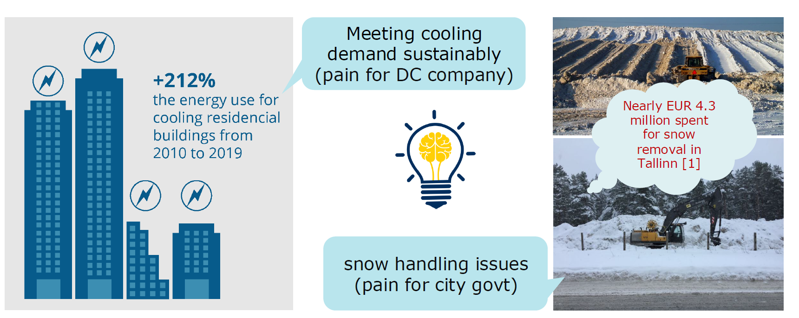
PROBLEM
1 Tallinn spent almost €4.3 million on snow clearing this winter | News | ERR
Notes:
Building cooling accounts for about 2.7% of overall energy use. This demand is predicted to increase three times by 2050
Despite the availability of natural snow in cold regions, there is lack of innovative technology and business model that would enable efficient utilisation of waste snow for space cooling application.
This gap prevents hospitality sector from leveraging a free, climate-friendly resource that could significantly reduce cooling costs and carbon footprint.

Slide 3
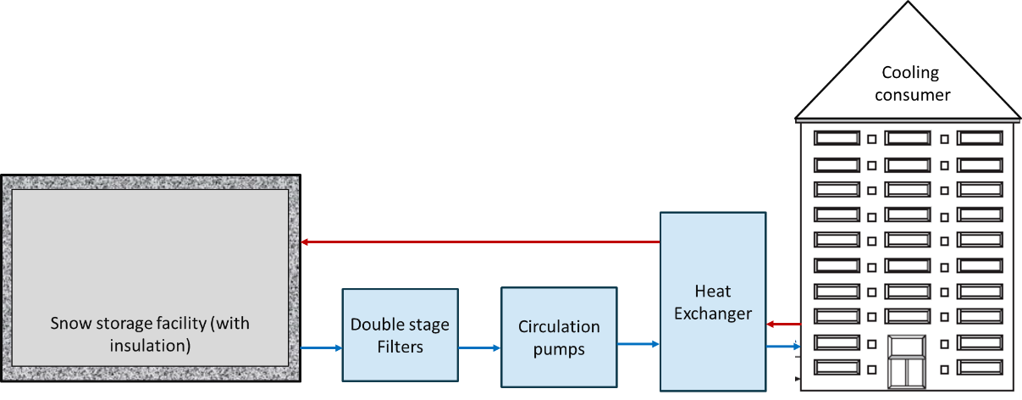
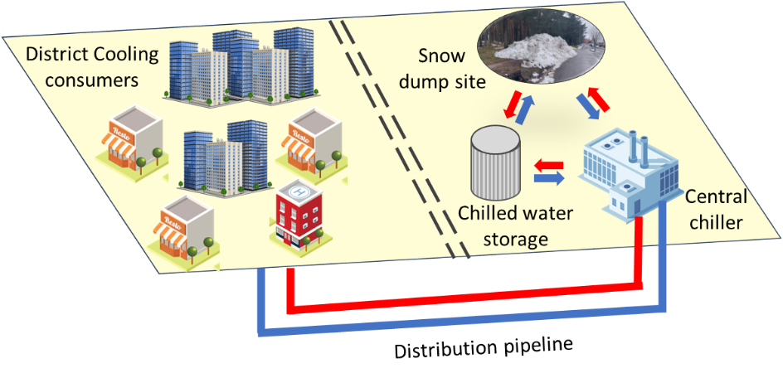
SOLUTION
Storing winter snow in insulated-pits & utilizing it for cooling during spring/summer
Missing part:
No tools for cost-benefit analysis
Not implemented at district level
Economics of scale in cooling production
Lack of awareness among stakeholders
Existing solution:
Technical feasibility is proven at building level²
Use of snow dump site for snow cooling facility
² Nordell (2015) Using ice and snow in thermal energy storage systems

Slide 4
CASE STUDIES - SNOW COOLING
Location | Year of Operation | Remarks
Oslo airport, Norway | 2016 | Energy savings of 375 MWh were achieved as compared with existing cooling systems
Office building in Oshu, Japan | 2002 | Improved system performance (EER = 6) by using snow as coolig source (ca. 26 tonnes)
Sundsvall Hospital, Sweden | 2000 | Around 77 % of the cooling demand was met from the snow storage system
Commercial building, Japan | Data not available | By utilizing renovated space, the initial cost was comparable to a conventional chiller
Implemented
Energy savings
Cost reductions

Slide 5
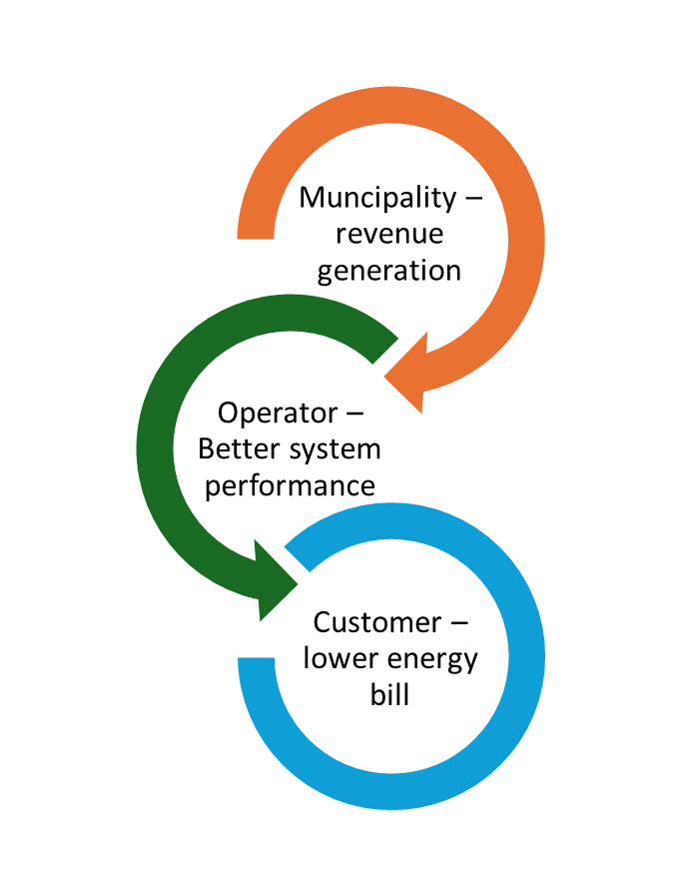
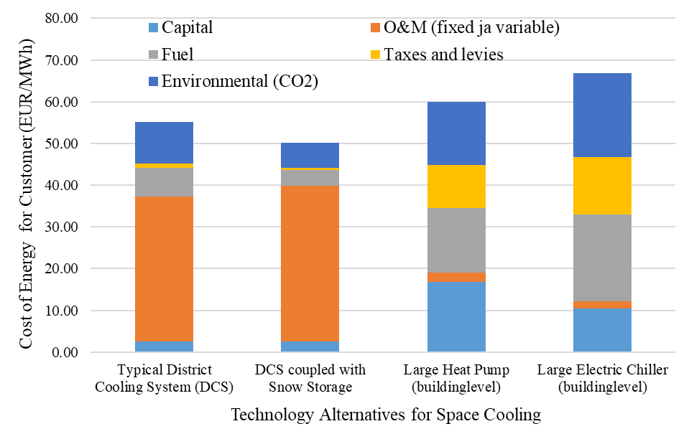
TECHNOLOGY COMPARISION*
* NB: accuracy of the estimated results are highly dependent on the user inputs and assumptions

Slide 6
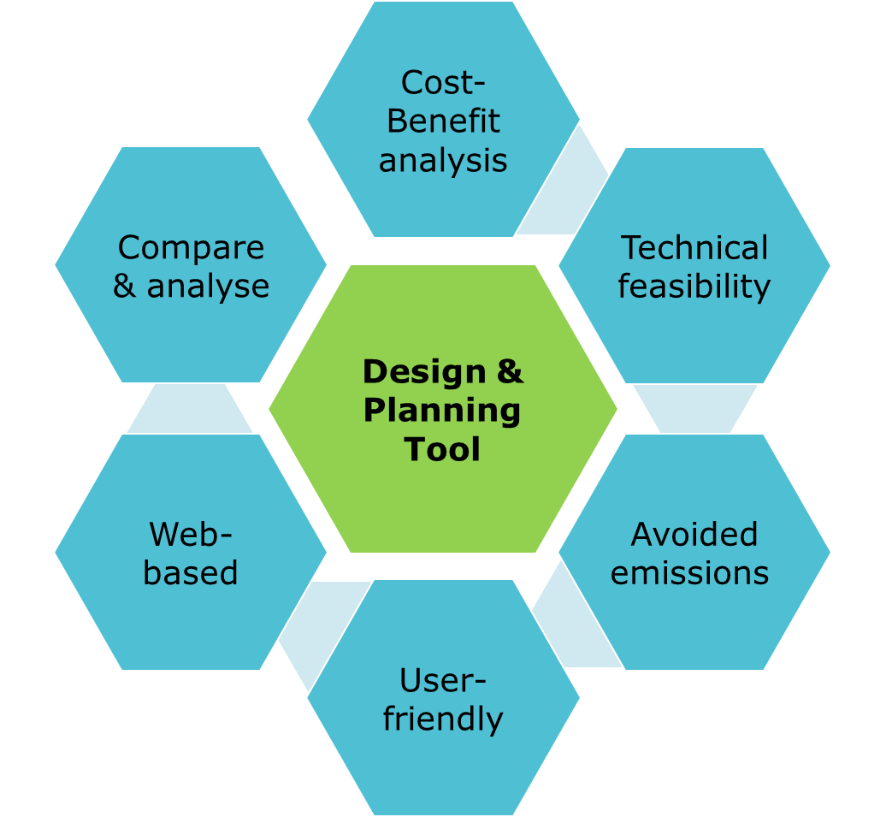
FOCUS (aka the Product)
Offer software as service - feasibility studies, expert consultations, project reports
Provide insights to cost optimal integration of snow storage into existing or planned district cooling system
Gain creator: estimation of energy savings, value of snow waste and initial investment
Pain reliever: estimation of the avoided carbon emissions, reduced cost of cooling and soil pollution

Slide 7
CLIENTS AND PARTNERS
Customer Segments
City municipality (B2G)
District cooling company
Real estate developers
Airports & hospitals (B2B)
Key Partners
City municipality
Construction companies
Technology providers
Snow handling companies
Nordic region
North America
Part of Asia

Slide 8
MARKET OPPORTUNITY
TAM =
$160 billion
TAM is estimated on the projected market size for air conditioners in 2025
District cooling has niche market & segmented market potential (SAM)
SOM is limited by the geographical scope of snow storage system
Favorable factors are large-scale applications and growing interest in sustainable cooling
SAM =
$31 billion
SOM = $3.1 billion
³https://www.fortunebusinessinsights.com/industry-reports/district-cooling-market-100090

Slide 9
CURRENT STATE
An easy-to-use tool is being developed, TRL level 3
The developed solution is partially related to ongoing ETAG research grant, funding up to September 2026
Future development needed in:
Validating beta-prototype with hypothetical cases
Validation of problem/need from major partners/clients
Developing preliminary business model
Clarifing the IPR; appling for trademark
Securing funding for development of toolkit

Slide 10
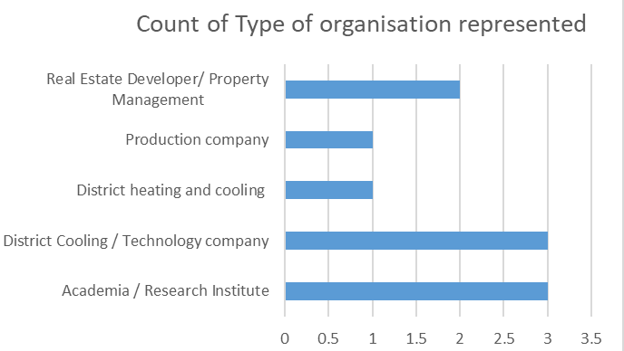
MARKET SURVEY & VALIDATION
Anonymous stakeholder survey (10 expert responses)
Concept validated by technical experts
Strong support for economic viability of snow storage
Strategic fit with district cooling confirmed
Market shows readiness; planning tools needed

Slide 11
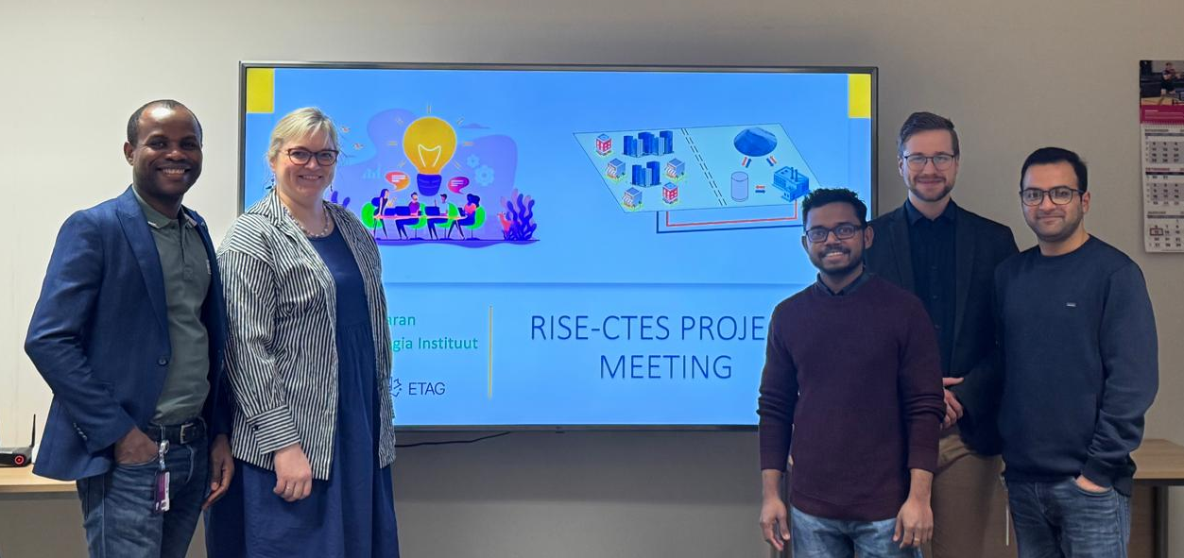
Team
Dr. Sreenath is the PI of the ongoing research project related to snow cooling
Supported by: Prof. Anna Volkova (Supervisor) and Siim Erik Pugal (Early-stage researcher)
He is working as scientific researcher at Dept. of Energy Technology, TalTech
Holds doctorate in Energy Sustainability from UMPSA, Malaysia
Recipient of research grants from Estonian Research Council
Future potential team competencies and background
In additon to current team:
Business development and sales in energy tech, with strong contacts base

Slide 12
Snowshine
XXXX XXXXXXX, potential CEO and CoFounder
LinkedIn: link

Slide 13

MARKET OPPORTUNITY (TAM, SAM, SOM)
INPUT BY POTENTIAL CEO
---

Slide 14
COMMERCIALIZATION PLAN
FROM LAB TO PRODUCT
INPUT BY POTENTIAL CEO
---

Slide 15
FINANCIAL PROJECTIONS:
PATH TO MAXIMIZE STARTUP VALUE
INPUT BY POTENTIAL CEO
---

Slide 16
VISION FOR FUTURE TEAM
INPUT BY POTENTIAL CEO
---

Slide 17
CONTRIBUTION
(TalTech will give options shares for the new co-founder, what is that you are willing to invest in terms of money, time and competencies and what are your expectations regarding option shares)
INPUT BY POTENTIAL CEO
I'm suitable to be the founding member ...
My contribution can be (time, money, competencies, contacts etc)
My expectations regarding option shares in startup founding stage is in the range of x-x%

