Slide 1
Higher Education Research Standing Committee
4-5 March, 2026

Slide 2
Education and Training – update

Slide 3

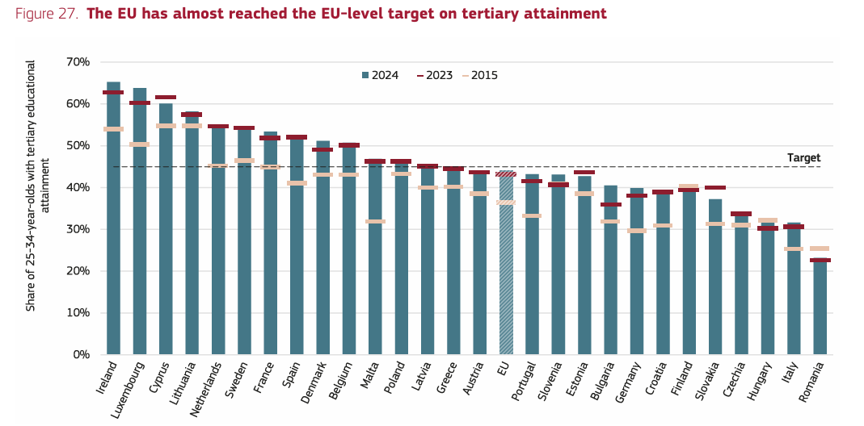
Education and Training Monitor 2025

Slide 4
Equal access
Rural-urban divide
Results for rural areas also improved rising from 26.9% in 2015 to 32.2% in 2024
But the gap between rural and urban areas increased
The concentration of universities in urban areas attracts students and labour market and impacts EU’s poorer regions more heavily making them even less attractive to people with a tertiary qualification and businesses.

Slide 5
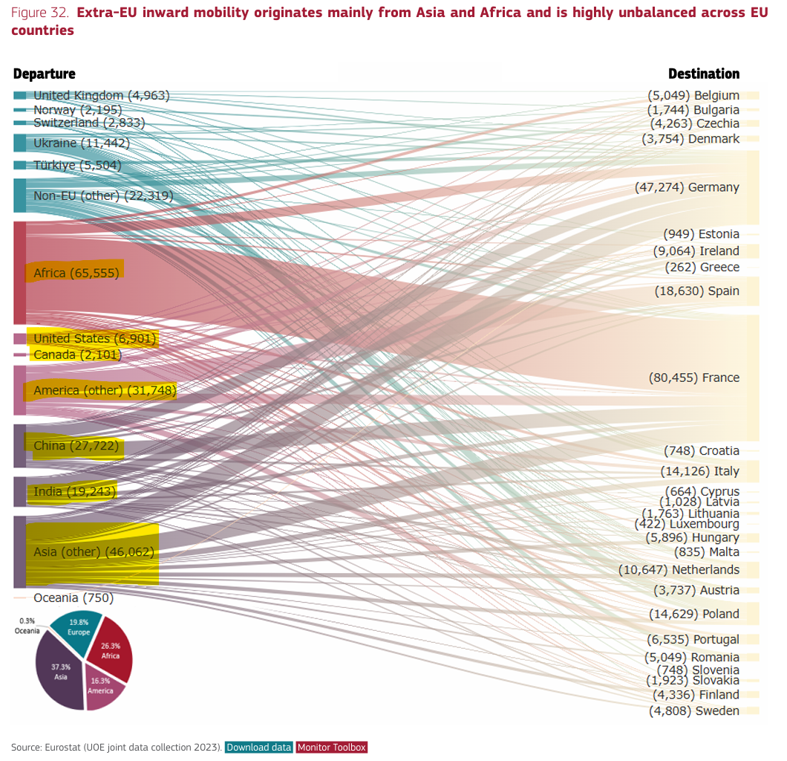
Internationalisation

Slide 6
Internationalisation – upcoming BFUG Plenary discussions
EU target for the EHEA: 23% mobility
BFUG target of 2009: 20% mobility by 2020 has not been reached (9.4% in 2017)
BFUG target of 2012: 15 ECTS earned in mobility
More balanced and accessible mobility by monitoring study programmes offered in English?
Different treatment of mobility of EU/EHEA countries and from other countries? (different principles, expectations, or policy instruments should apply?)

Slide 7
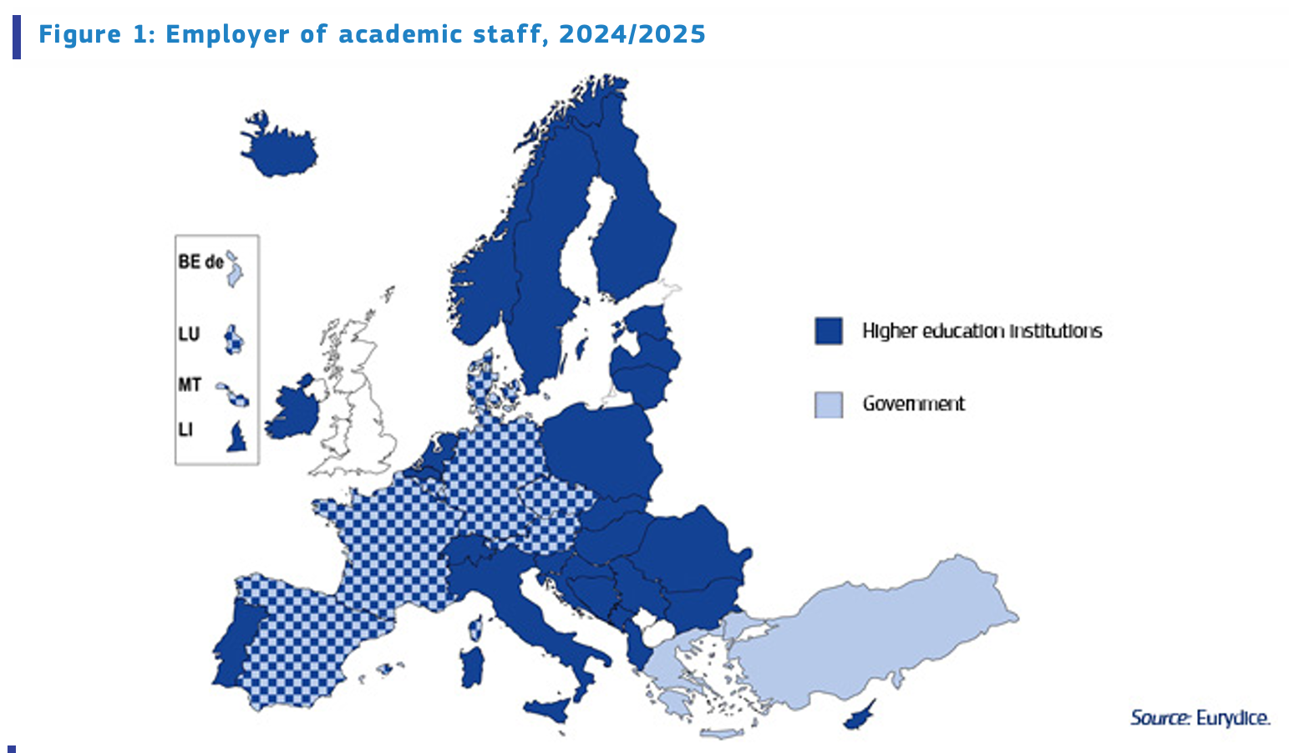
Eurydice on Academic Staff 2025

Slide 8
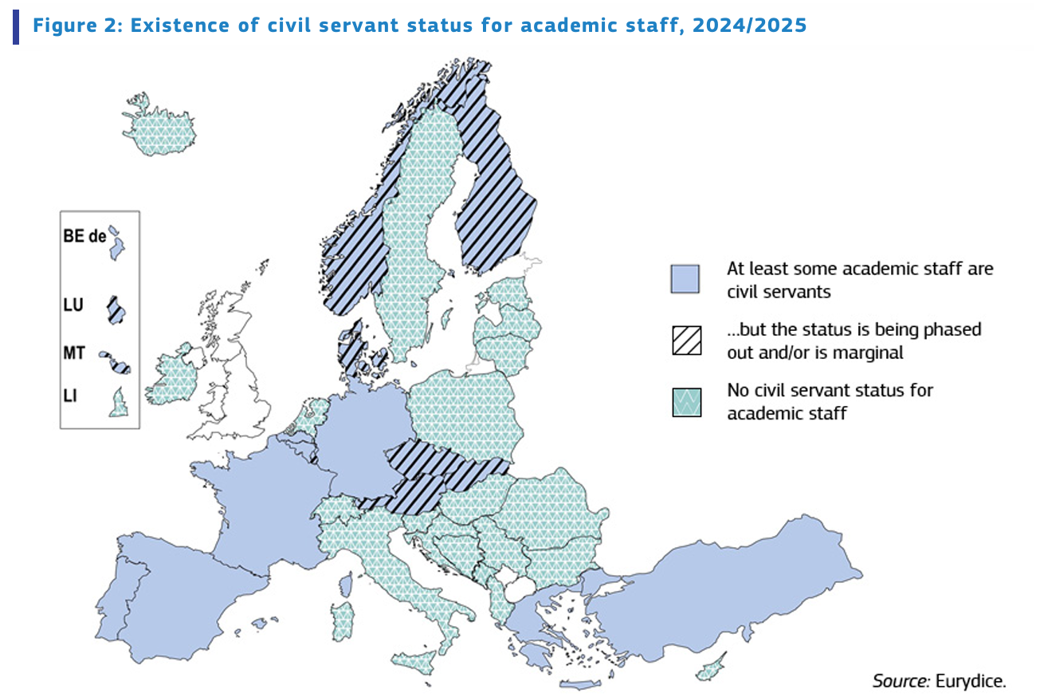

Slide 9
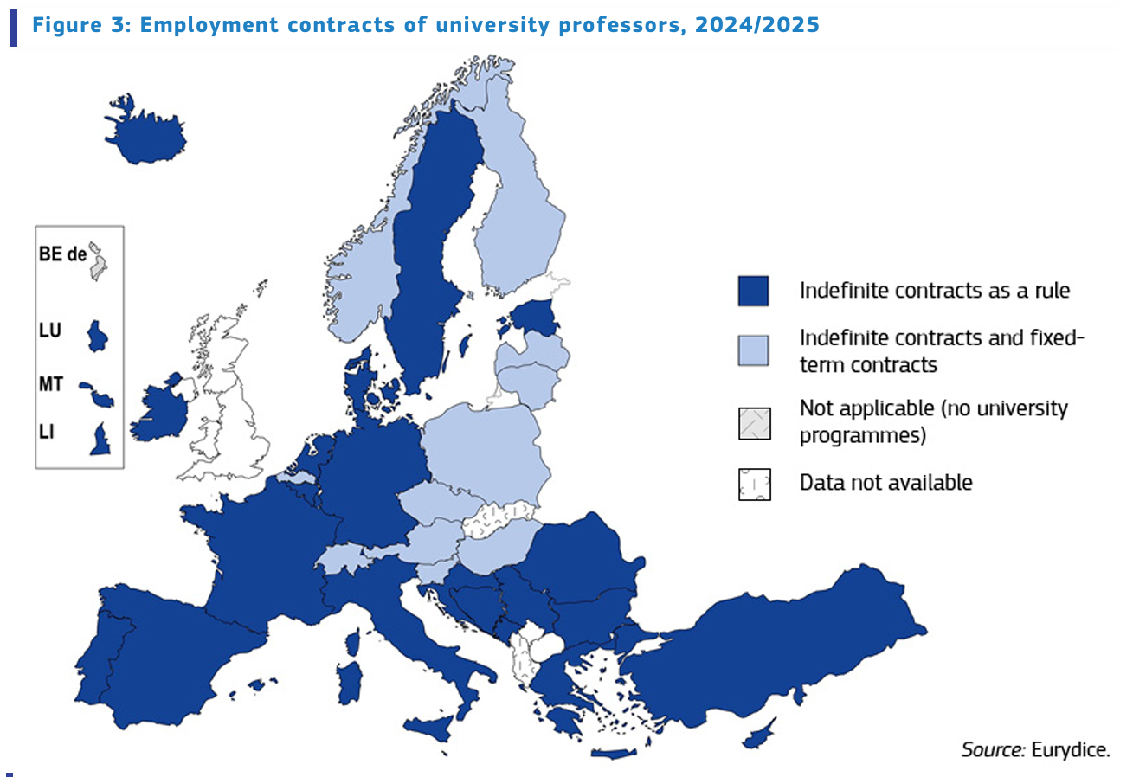

Slide 10
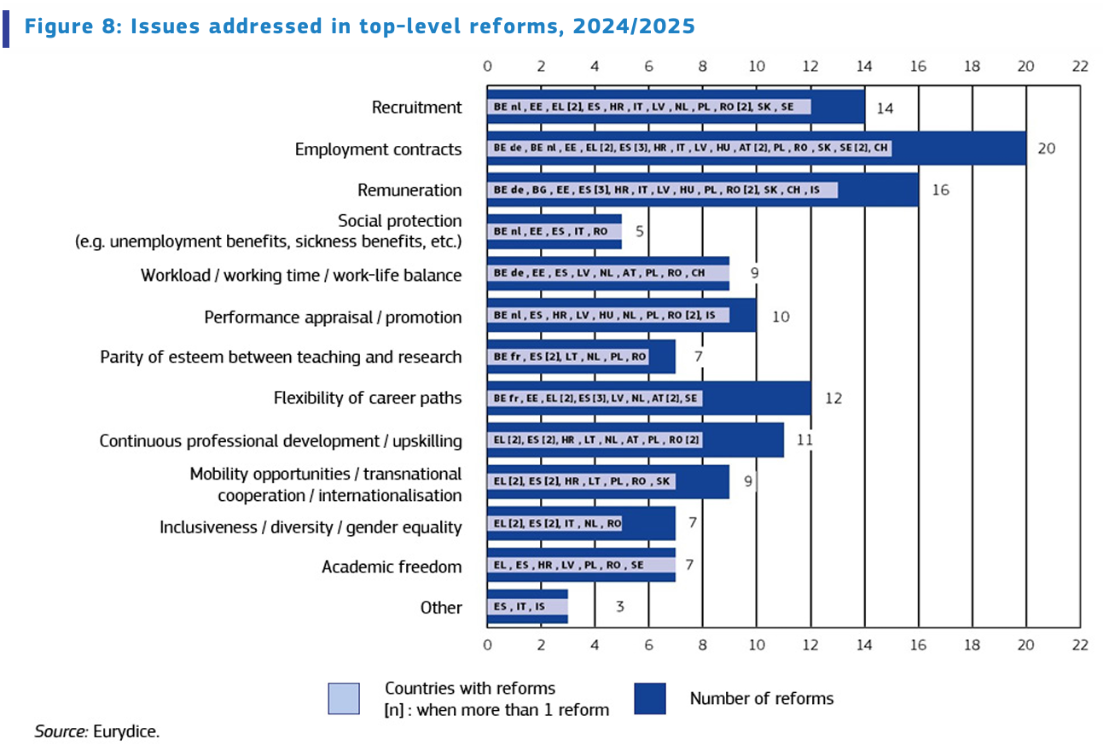

Slide 11
⁠Draft Council Resolution on the second cycle of the strategic framework for European cooperation in… as part of the Outcomes of Education Council – 27-28 Nov. 2025
Focus on: strengthening the governance of the European Education Area can be achieved within the current structures
In 2026-2030, the European Education Area strategic framework will address:
Strategic priority 1: Literacy, mathematics and science for all
Strategic priority 2: Developing digital skills and citizenship education
Strategic priority 3: Making lifelong learning and mobility a reality for all
Strategic priority 4: Enhancing attractiveness, competences and motivation in the education and training profession (not very supportive text)
Strategic priority 5: Fostering excellent and attractive European vocational education and training (VET)
Strategic priority 6: Promoting competitive European higher education

Slide 12
Outcomes of Education Council – 27-28 Nov. 2025
Strategic priority 6: Promoting competitive European higher education
“accessibility of higher education should be broadened by creating opportunities for learners of all ages and backgrounds and by designing flexible learning pathways that promote lifelong learning, recognition of prior learning and support the well-being of students and staff. ”
“It will be equally crucial to safeguard fundamental academic values (including academic freedom) and acknowledge the role of higher education institutions in supporting the future development of democratic societies.”
“Academic staff are essential for thriving European higher education institutions and deeper transnational cooperation. To address the challenges they face, it is necessary to support initiatives that recognise and acknowledge the value of their diverse roles and the importance of attractive and sustainable careers in higher education. “
But: “Stronger cooperation between higher education institutions and economic sectors is vital for the alignment of educational offerings with evolving labour market demands. ”

Slide 13
ETUCE Position on Erasmus Programme 2028-34
Cypriot Council Presidency and European Parliament works on on Erasmus+ proposal.
ETUCE calls for Erasmus+ 2028–2034 to
improve quality and inclusiveness of education rather than being reduced to a labour-market tool and an adjunct to the competitiveness agenda (a central policy of the Union of Skills initiative).
EU funding must complement, not replace, national investment in education and teachers.
Erasmus+ strengthens quality education, democratic values. It should prioritize education’s broader societal role, promoting democracy, equality, and intercultural dialogue,

Slide 14
ETUCE Position on Erasmus Programme 2028-34
It calls for Erasmus+ 2028–2034 to
add objectives such as improving the attractiveness of the teaching profession, supporting teacher well-being, and recognizing mobility as continuing professional development.
Set inclusive governance with a permanent role for education trade unions at EU and national levels, transparent decision-making on priorities and budgets, and guaranteed teacher participation through removal of mobility barriers, recognition of mobility for career progression, and adequate financial support.
Next step: European level and national level lobby

Slide 15
European Parliament prepares a report on Erasmus+. ETUCE demands:
Academic freedom & fundamental values: Mobility and projects should actively respect and promote academic freedom, freedom of speech, institutional autonomy and democratic participation. – respect of Charter of Fundamental Rights (freedom of speech, rule of law, and working conditions)
Strong social dialogue & collegial governance: Erasmus+ should support democratic governance in higher education, linking green and digital transitions to staff wellbeing and working conditions.
Sustainable funding & decent work - reduce precarity in the sector. Participation in projects should be linked to adequate staffing, permanent contracts and long-term institutional funding.
Fair mobility for teachers & academics: Mobility should not mean loss of salary, pension or social rights. It must be recognised as paid professional development.
Inclusive governance: Teachers are central to Erasmus+ and must have a formal, permanent voice in programme governance at EU and national level

Slide 16
European Parliament Academic Freedom Monitor
Across the EU, academic freedom is under growing pressure, and many of the developments identified in the 2025 Monitor have direct implications for working conditions, governance, and autonomy Academic freedom is declining in many Member States: it has worsened over the past decade in 8 EU countries (AT, FI, DE, EL, HU, LT, PL, PT). Reasons: Political interference: funding cuts, political appointments, and security‑driven limits on research weaken institutional autonomy (significant declines in Finland, Germany, Greece, Hungary, Lithuania, Poland, Portugal). Managerial pressure: centralised governance, performance metrics, and precarious contracts erode staff voice and independence.

Slide 17
European Parliament Academic Freedom Index
Reasons: Internal tensions: harassment and polarisation inside academia lead to self‑censorship (e.g. 45% of Flemish academics report harassment). Societal attacks: online abuse and intimidation of researchers, especially in social sciences and humanities. Commercialisation risks: dependence on private funding can subtly distort research agendas. Foreign interference: pressure from China and security‑based restrictions (e.g., US policy impacts, national security filters) threaten open collaboration.

Slide 18
ETUCE Position on HorizonEurope Programme 2028-34
The position paper call for Horizon Europe :
Be a distinct, research-first programme that safeguards academic freedom, institutional autonomy, and the integrity of fundamental research, resisting any dilution by competitiveness agendas.
EU funding complements, rather than replaces, national investment, with significant resources allocated to curiosity-driven research and measures to reduce regional disparities.

Slide 19
ETUCE Position on HorizonEurope Programme 2028-34
The position paper call for Horizon Europe :
strengthen its social mission by supporting non-market, public-interest research in social sciences, humanities, and education.
make research careers attractive and sustainable by tackling precarity, introducing social conditionalities and inclusion & gender equality plans in grant agreements, ensuring fair pay, safe working conditions, and predictable mobility with full portability of grants and recognition of prior experience.
guarantee social protection for mobile researchers, harmonize recognition of qualifications and career progression across borders, and provide clear job-quality standards linked to collective agreements, ensuring that research careers are secure, equitable, and aligned with the values of the European Research Area.

Slide 20
Discussion
What support would higher education and research staff and their trade unions need? What would you like that ETUCE achieves on higher education and research in the next years?
How we best can work together, to feed into ETUCE strategic priorities and in order to strengthen our advocacy and impact?
What tools can ETUCE and member organisations use in order to shape European policies? Eg informing/mobilising members on EU policy developments; informal cooperation & formal social dialogue with ministries; set alliances; etc

Slide 21
Report on BFUG developments

Slide 22

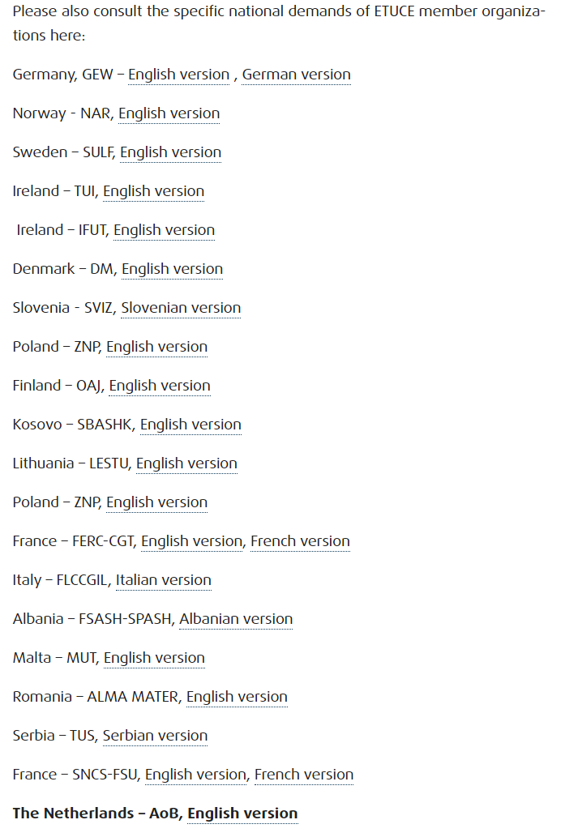

Slide 23
 | BFUG
 | BFUG Plenary meetings | Rob Copeland, UCU Agnes Roman, ETUCE
1. | WG Monitoring the Implementation of the Bologna Process | Rob Copeland, UCU
2 | WG Taskforce on Future of Bologna | Andreas Keller, GEW
3. | WG Fundamental Values | Karin Amossa, SULF
4 | WG Internationalisation and mobility | Alessandro Arienzo, FLCGIL
5. | WG Global Policy Dialogue | Hanna Tanskanen, OAJ
6. | Thematic Peer Group on Social Dimension | Annette Dolan, TUI
7. | Thematic Peer Group on Quality Assurance | Andreas Keller, GEW
9. | Thematic Peer Group on Qualifications Frameworks | no representative.
10 | Thematic Peer Group on Recognition | no representative.
11 | Thematic Peer Group on Long-term secretariat | Closed group, no representative.
12 | Drafting Committee of the Communique | ESU
EUROPEAN COMMISSION’S WORKING GROUPS
European Commission European Education Area WORKING GROUP on Higher education (2021-25) | Karin Åmossa, SULF
European Commission’s WORKING GROUP on Graduate tracking | Agnes Roman, ETUCE
Director-Generals of Higher Education meeting | Ad-hoc invitation
European Quality Assurance Registry
EQAR General Assembly meeting | Rob Copeland, UCU Agnes Roman, ETUCE
EQAR Extraordinary General Assembly | Agnes Roman, ETUCE
EQAR Register Committee meetings | Petri Mäntysaari, FUUP
EQAR Members’ Dialogue | Representation is coordinated
 | PROJECTS
 | ENQA Project on ESG Revision 2023-27 | Ole Espen Rakkestad, Utdanningsforbundet

Slide 24
Iași – Chișinău Ministerial Conference and Global Policy Forum – 26-27 May 2027
TASKS:
Lobby on the Ministerial Communique. Drafting Group: Cyprus, Norway, Ireland, Montenegro, Lithuania, North Macedonia, Romania, European Students’ Union (ESU)
HERSC Call – please translate it/add national demands and send it to your ministry
Trade unions in national delegation -> Please check trade unions in the EHEA website
Are there any trade unions of higher education from non-HERSC member countries who could be members of ETUCE?

Slide 25
BFUG Plenary meeting – December 2025
Topics discussed:
- Updates from BFUG working groups
- Lifelong learning in higher education
- Shortlist of candidate for hosting BFUG Permanent Secretariat: DE, CZ, RO
- Application of ETUCE to extend the national representations of the Ministerial conference

Slide 26
BFUG Plenary meeting – 9-10 March 2025
Topics discussed:
- Shortlist of candidate for hosting BFUG Permanent Secretariat: DE, CZ, RO
Application of ETUCE to extend the national representations of the Ministerial conference
ESG Revision
Key commitments – how to monitor them if there is no engagement by the MS?
Reporting on qualifications
Internationalisation

Slide 27
Internationalisation – upcoming BFUG Plenary discussions
EU target for the EHEA internal mobility: 23% of students
BFUG target of 2009: 20% mobility by 2020 has not been reached (9.4% in 2017)
BFUG target of 2012: 15 ECTS earned in mobility
More balanced and accessible mobility by monitoring study programmes offered in English?
Different treatment of mobility of EU/EHEA countries and from other countries? (different principles, expectations, or policy instruments should apply?)

Slide 28
Internationalisation
Eurydice report
Main sending regions/countries (non‑EU → EU) The largest groups of incoming students to the EU come from: Africa – the single largest source region (≈65,500 students). Asia –including: China (≈27,700) India (≈19,200) Asia – other (≈46,000) United States (≈6,900) and Canada (≈2,100) Non‑EU Europe such as: Ukraine (≈11,400) Turkey (≈5,300) United Kingdom (≈4,900)

Slide 29
Internationalisation
Eurydice report
Main destination of student mobility to EU countries France – by far the largest host (≈80,500 students) Germany – (≈47,300) Spain – (≈18,600) Italy – (≈14,100) Netherlands – (≈10,600) Ireland, Belgium, Poland, Portugal, and Romania receive moderate numbers.

