Slide 1
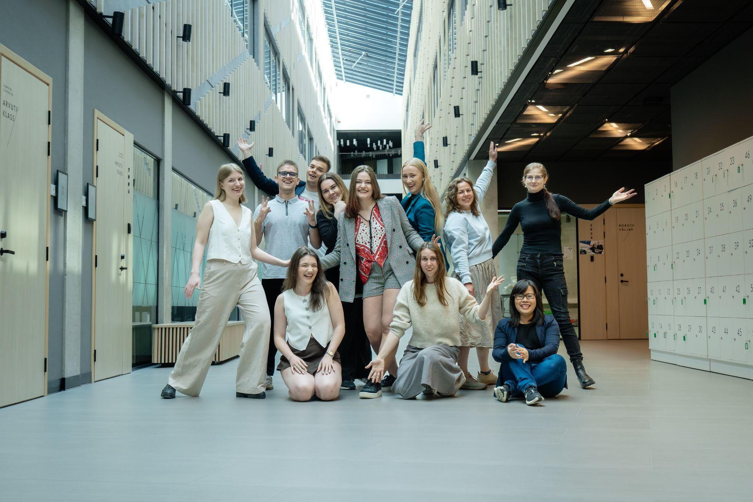








Slide 2
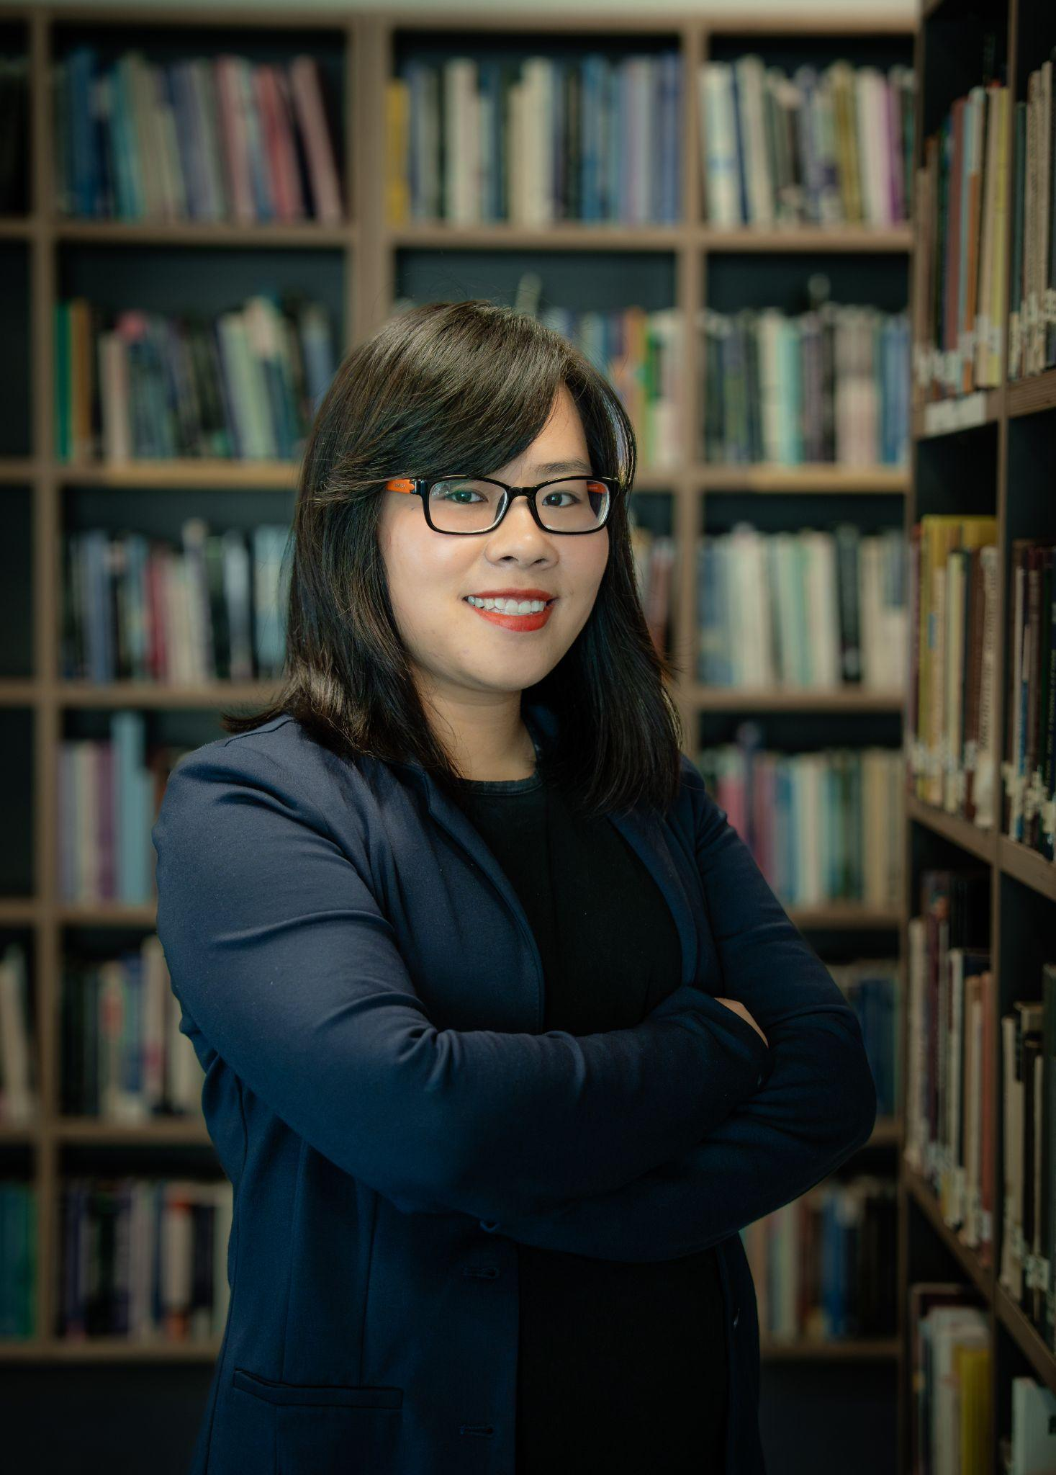
“The MIMIR Fellows program has been one of the most exciting learning experiences for me. I was able to piece together a clearer understanding of the complex world of innovation, venture capital, deep tech, and technology transfer.”
Fellow 2025
Notes:
‹#›

Slide 3
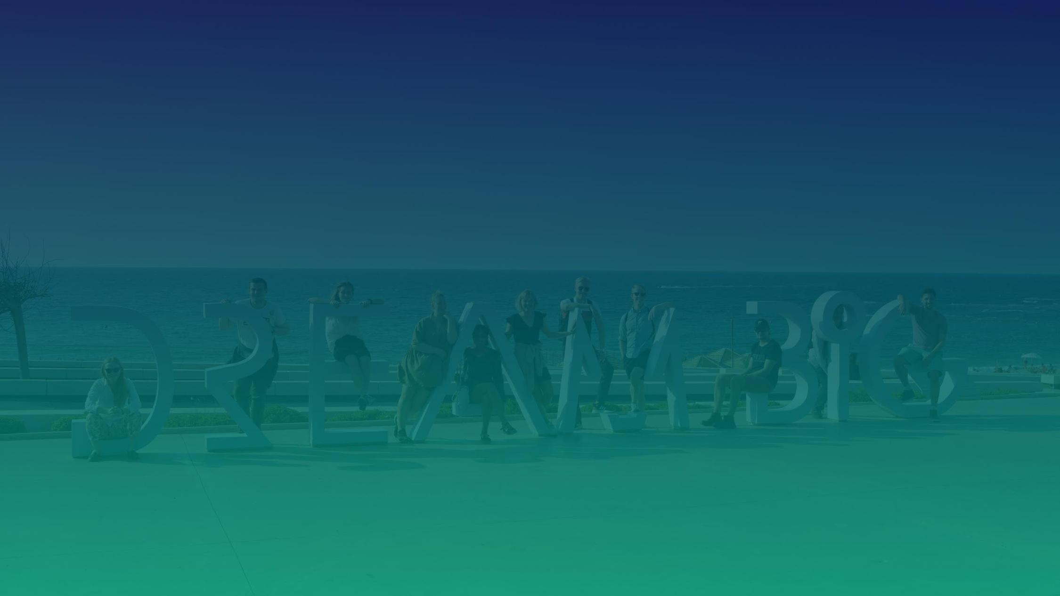
WHY are we here?
We are turning the Nordics into global leaders in research commercialization, with students leading the way
At MIMIR, we believe that science and researchers should be at the forefront of solving our most pressing global challenges. Impactful research commercialization will require educating a new generation of entrepreneurs with a deep appreciation of science.
This generation has already proven their power in changing mindsets when it comes to opening our eyes to the severity of climate change. By joining forces, we believe that we can find better ways to bring research into society based on our Nordic values and the needs of tomorrow.
Notes:
‹#›

Slide 4
What to Expect?
Pre-readings
Bootcamp
Study Project
Thorough materials that help you get in the scene of tech, transfer, venture capital and the startup world in general. You will work through these and conduct a small interview with us to go over them and clear any uncertainties about the topics.
This the core of the program - 2 intensive weeks (June 1-11) with over 30 speakers from the Estoninan deep tech ecosystem to broaden your view. We bring in both founders, investors, researchers and public sector representatives to create a puzzle for you to put together and start solving world’s most pressing challenges.
You will organize a project together with the Fellows to put what you have learned into action. This can be an event, campaign or any other form of impactful action that brings forth the importance of research commercialization and helps to solve world’s challenges.

Slide 5
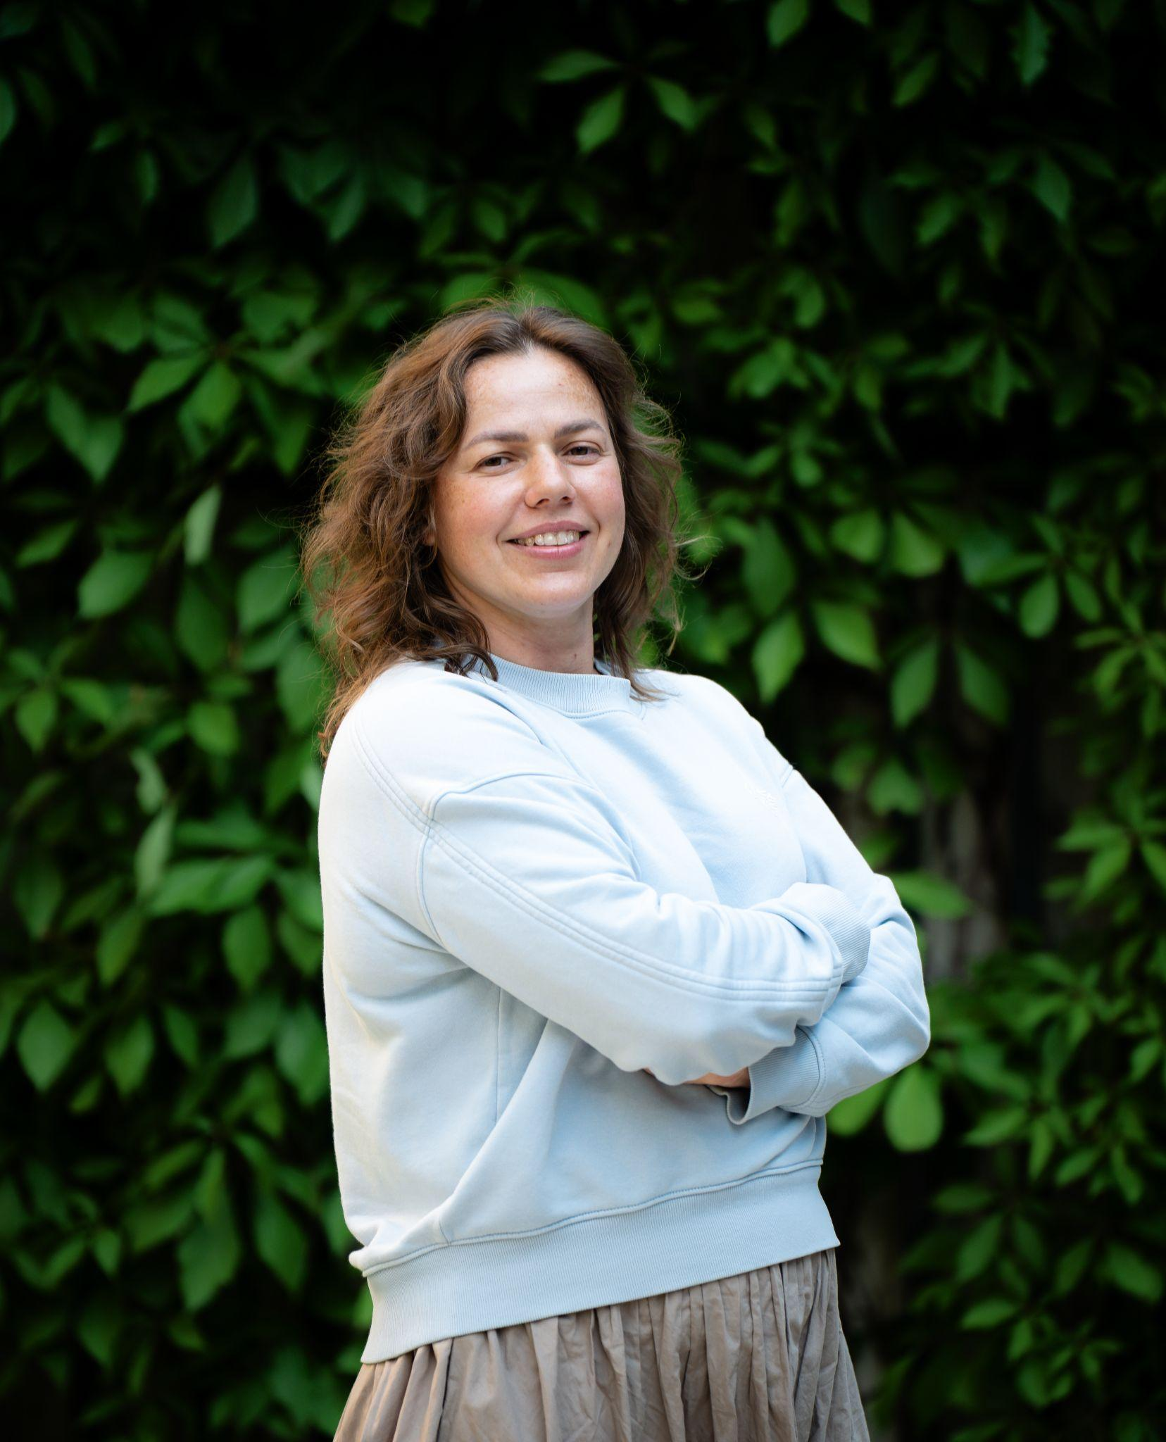
“I am sure that MIMIR Fellows is not just to move fast,
but to go far. And that means going together.”
Fellow 2025
Notes:
‹#›

Slide 6
ADAM GRANT
Give and Take
TAKERS
MATCHERS
GIVERS
Takers are those selfish folks who always have a sharky angle and forever put their personal interests ahead of everybody else’s. The main sign that someone’s a taker is kissing up and kicking down.
Matchers view the world in terms of fairness and balanced ledgers—I scratch your back, with the unstated but firm understanding that at some point you will scratch mine.
Givers perform all sorts of selfless acts with no expectation of reciprocity. Givers share credit without demanding any in return, which spurs co-workers to flock to their projects. Their generosity earns them deep and lasting respect, which translates into potency.
We often assume that the people most likely to zoom ahead within organizations are the ruthless, pragmatic types who are always looking for ways to benefit themselves. Grant’s research shows that, contrary to conventional wisdom, nice guys actually finish first.

Slide 7
LAST YEAR’S SCHEDULE
 | MONDAY, JUNE 9 | TUESDAY, JUNE 10 | WEDNESDAY, JUNE 11 | THURSDAY, JUNE 12 | FRIDAY, JUNE 13
9:15 AM
10:00 AM
11:30 AM
1:00 PM
 | L | U | N | C | H
2:00 PM | L | U | N | C | H
3:30 PM
4:45 PM
5:30 PM
Preparing for the day
Breaking the ice
WALID EL CHEIKH
The role of patents in university-industry cooperation
RAINIS VENTA
Avoiding the Unnecessary Legal Challenges
SANDER KÄRSON
Why EU still struggles to commercialize & how we fix it
AHMED HADI
Deep Tech Ecosystem & Supporting EU Networks
SVEN PARKEL
Venture Capital 101
LINDA VÕERAS
TIIVIK PREPARATION
Successful use cases of Public Funding
MARIANN PROOS
Inside the TTO: Translating Science into Startups
RELIKA ALLIKSAAR WILLIMAS
LUNCH
From basic science to startup company: a semi random walk
ARVI JÕERS
Bridging science and entrepreneurship
TRIINU LÖÖVE
TIIVIK DEMODAY
Working with UniTartu Ventures
KADRI SUNDJA
Growing into a leader
REMO OJASTE
Realizing the potential of the youth (intro to MIMIR)
GHITA WALLIN
From materials science to sports engineering: story of LIUG SportTech
JANNO TOROP
Delta labs + scientists
Marketing the Future: How to sell an Invisible Product
KARL-GUSTAV TAMBERG
Wrap-up of the day
Wrap-up of the day
Notes:
An investor’s perspective on universities
ILKKA KIVIMÄKI

Slide 8
LAST YEAR’S SCHEDULE
 | MONDAY, JUNE 16 | TUESDAY, JUNE 17 | WEDNESDAY, JUNE 18 | THURSDAY, JUNE 19 | FRIDAY, JUNE 20
9:15 AM
10:00 AM
11:30 AM
1:00 PM
 | L | U | N | C | H
2:00 PM | L | U | N | C | H
3:30 PM
4:45 PM
5:30 PM
Preparing for the day
Preparing for the day
Textile Technology's Possibilities to Create Systemic Change
TIIA PLAMUS
IP in Practice - TalTech's perspective
ANDRI SOKKA
My Journey with Gelatex
MÄRT-ERIK MARTENS
Fireside chat about the future
TERHI VAPOLA
SafePas: Joining a Tech Team to Commercialize Research
IVO KULDMÄE
Startup Support Systems to Drive Innovation
ANU PUUSAAG
Why NOT to startup?
PRATEEK SINGH
Keeping Your Cap-Table Clean
JAAN KOKK
Navigating the patent landscape in deep tech commercialization
MIKK PUTK
My Journey with Change Ventures
YRJÖ OJASAAR
Government’s Role in Leading Innovation
ANDRES SUTT
LUNCH
Building the Nordic Deep Tech Hub
MART MAASIK
Investing as an angel
KARIN KÜNNAPAS
Students to Space and Spinouts
SIRLI SARAPUU
TBA
feedback & reflection
My Vision for Estonia
RAIDO PIKKAR
Fund of Funds Investing
SILLE PETTAI
ÄIO:Accessing Academia to Build a Deep Tech Startup
MARY-LIIS KÜTT
Galttec - Finding My Passion
LAURA ELISE ARVISTO
Wrap-up of the day
*in italics to be confirmed

Slide 9
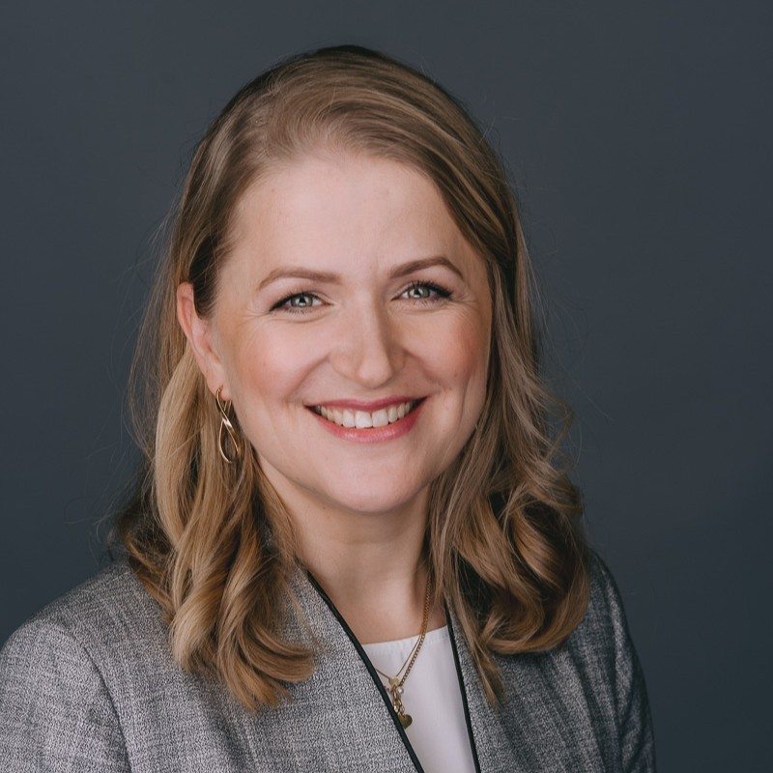
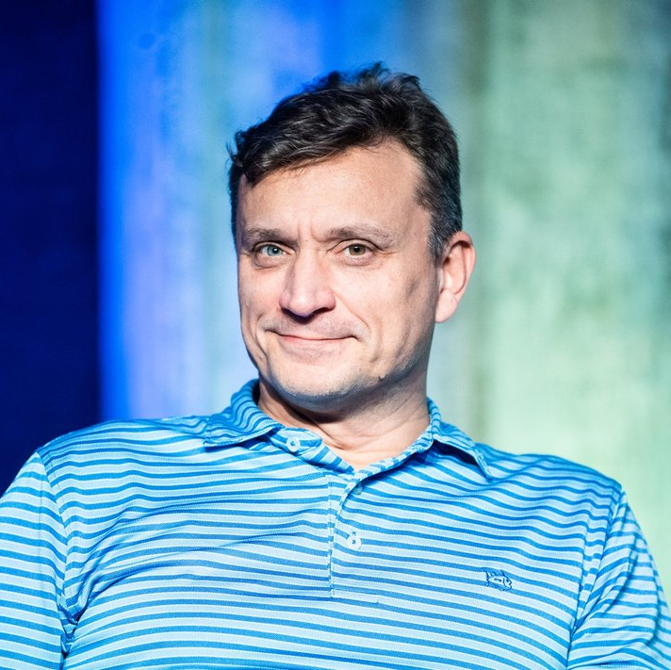
“This kind of program is very necessary. There should be many more like these to reach more students, because only then we can start changing the world!”
Relika Alliksaar Williams
“I was happy to meet everyone and even better that the students got something useful out of it.”
Yrjö Ojasaar

Slide 10
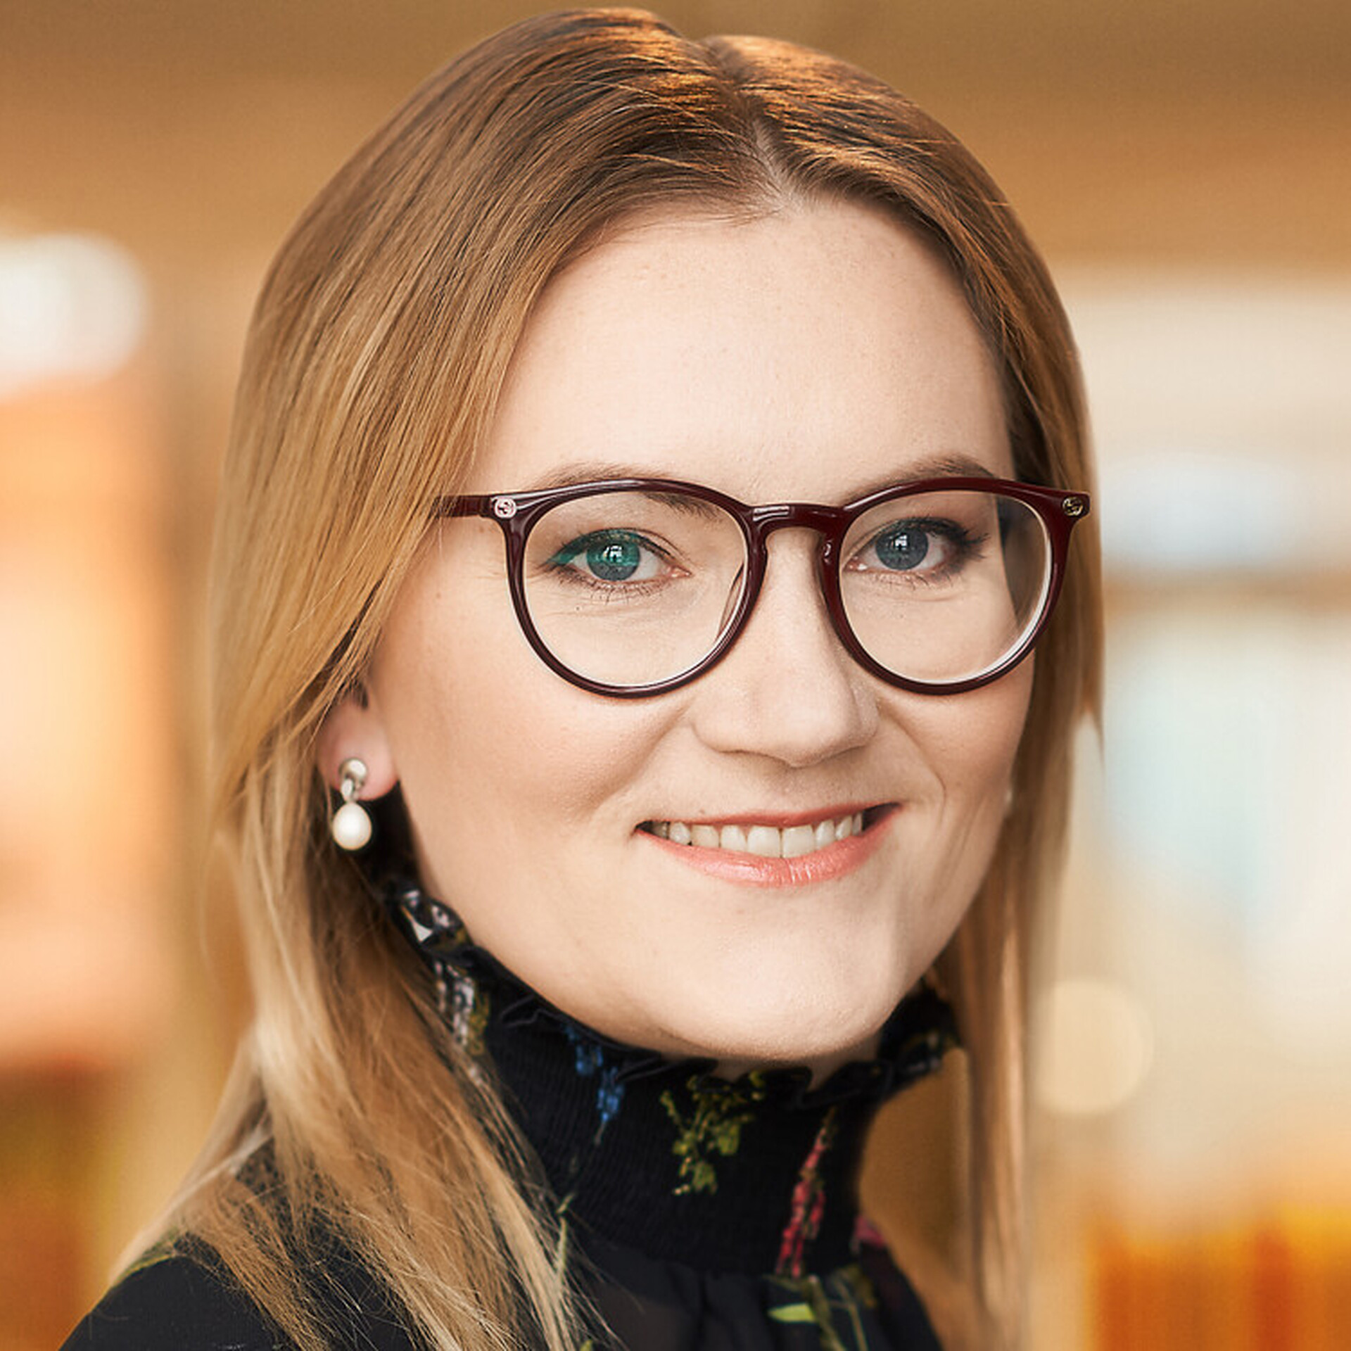
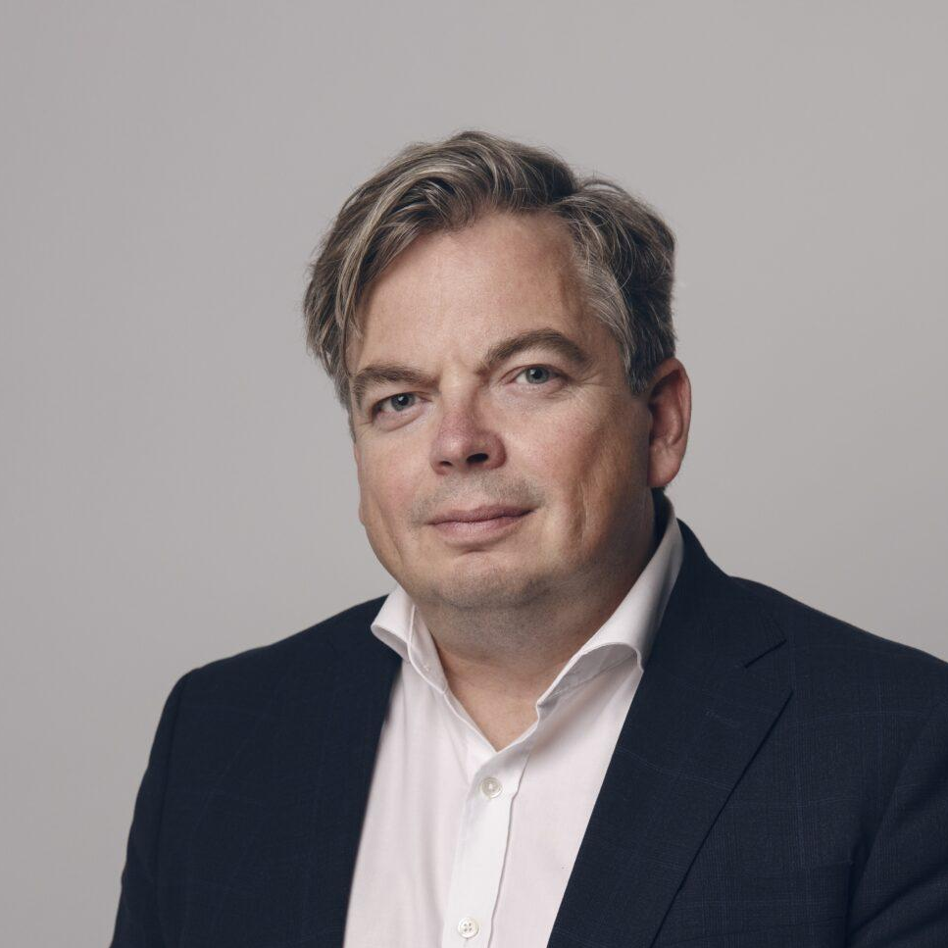
“Thank you! The students that you had were really motivated and dedicated!”
Sille Pettai
“I experienced yet again how inspiring the participants’ curiosity and dedication is. MIMIR gives access to connections to exchange experiences and create the critical mass of talent in the field.”
Mart Maasik

Slide 11
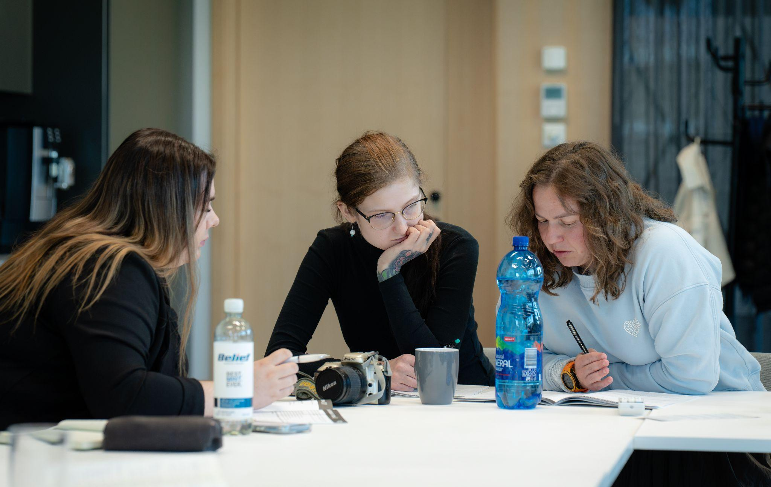
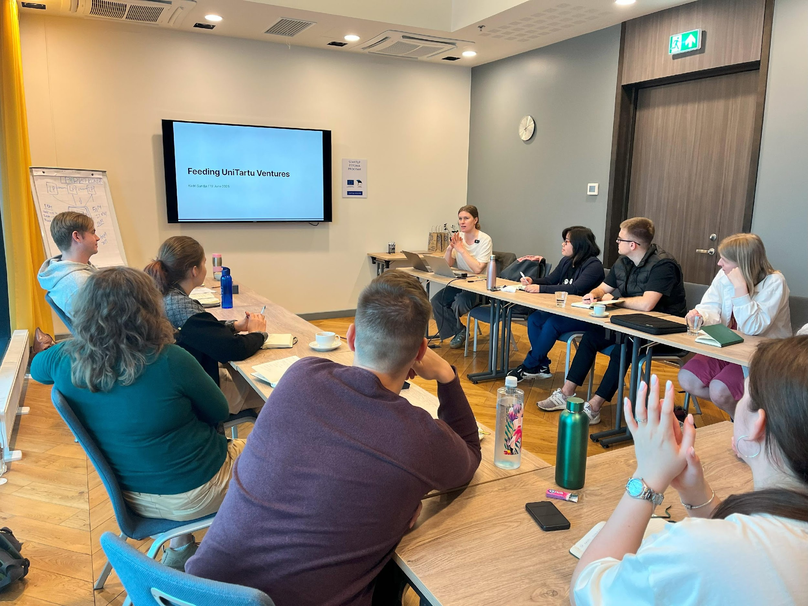
Kadri Sundja’s session
Teamwork workshop
Notes:
‹#›

Slide 12
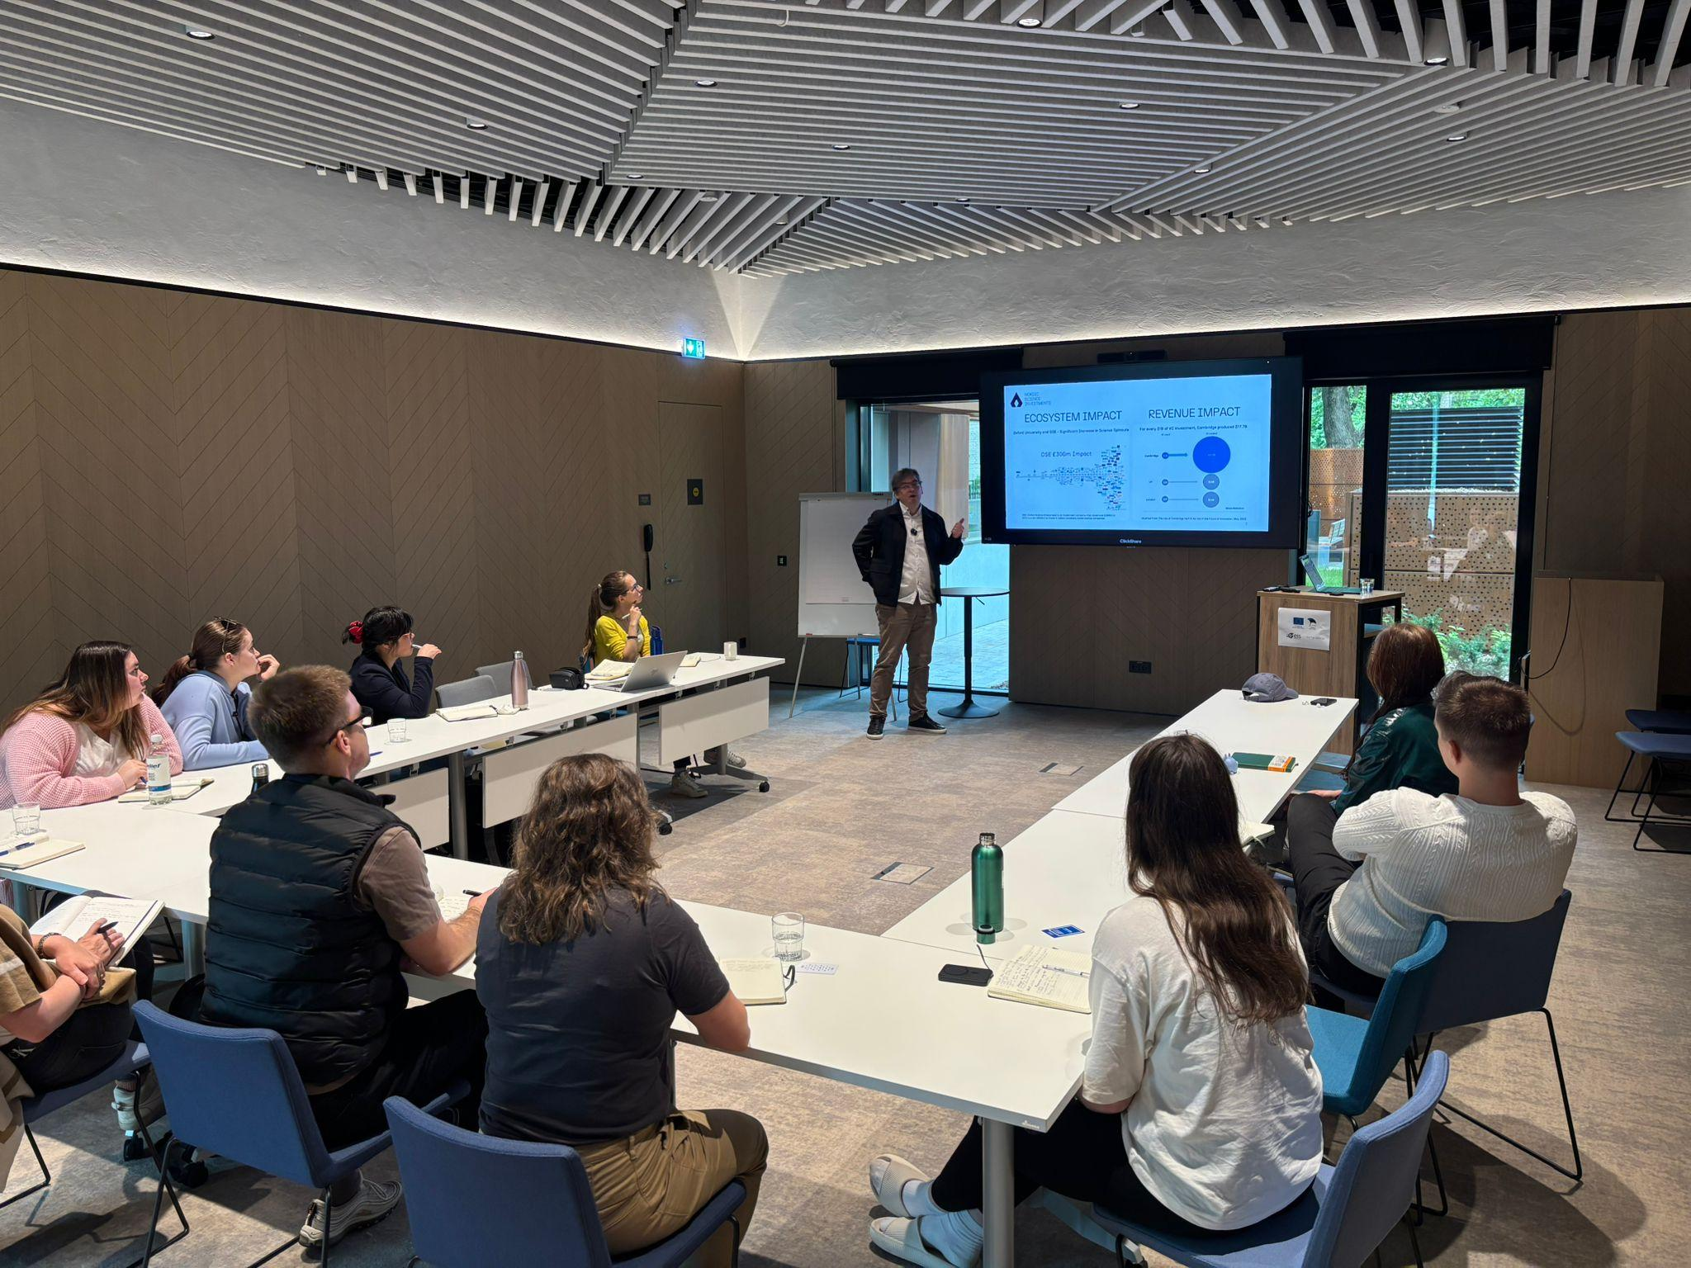
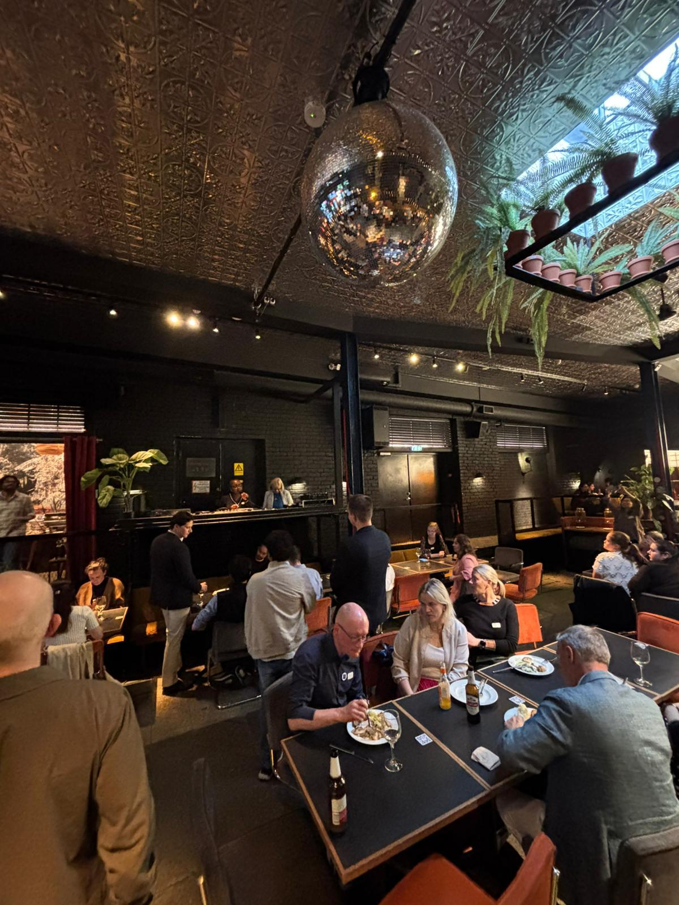
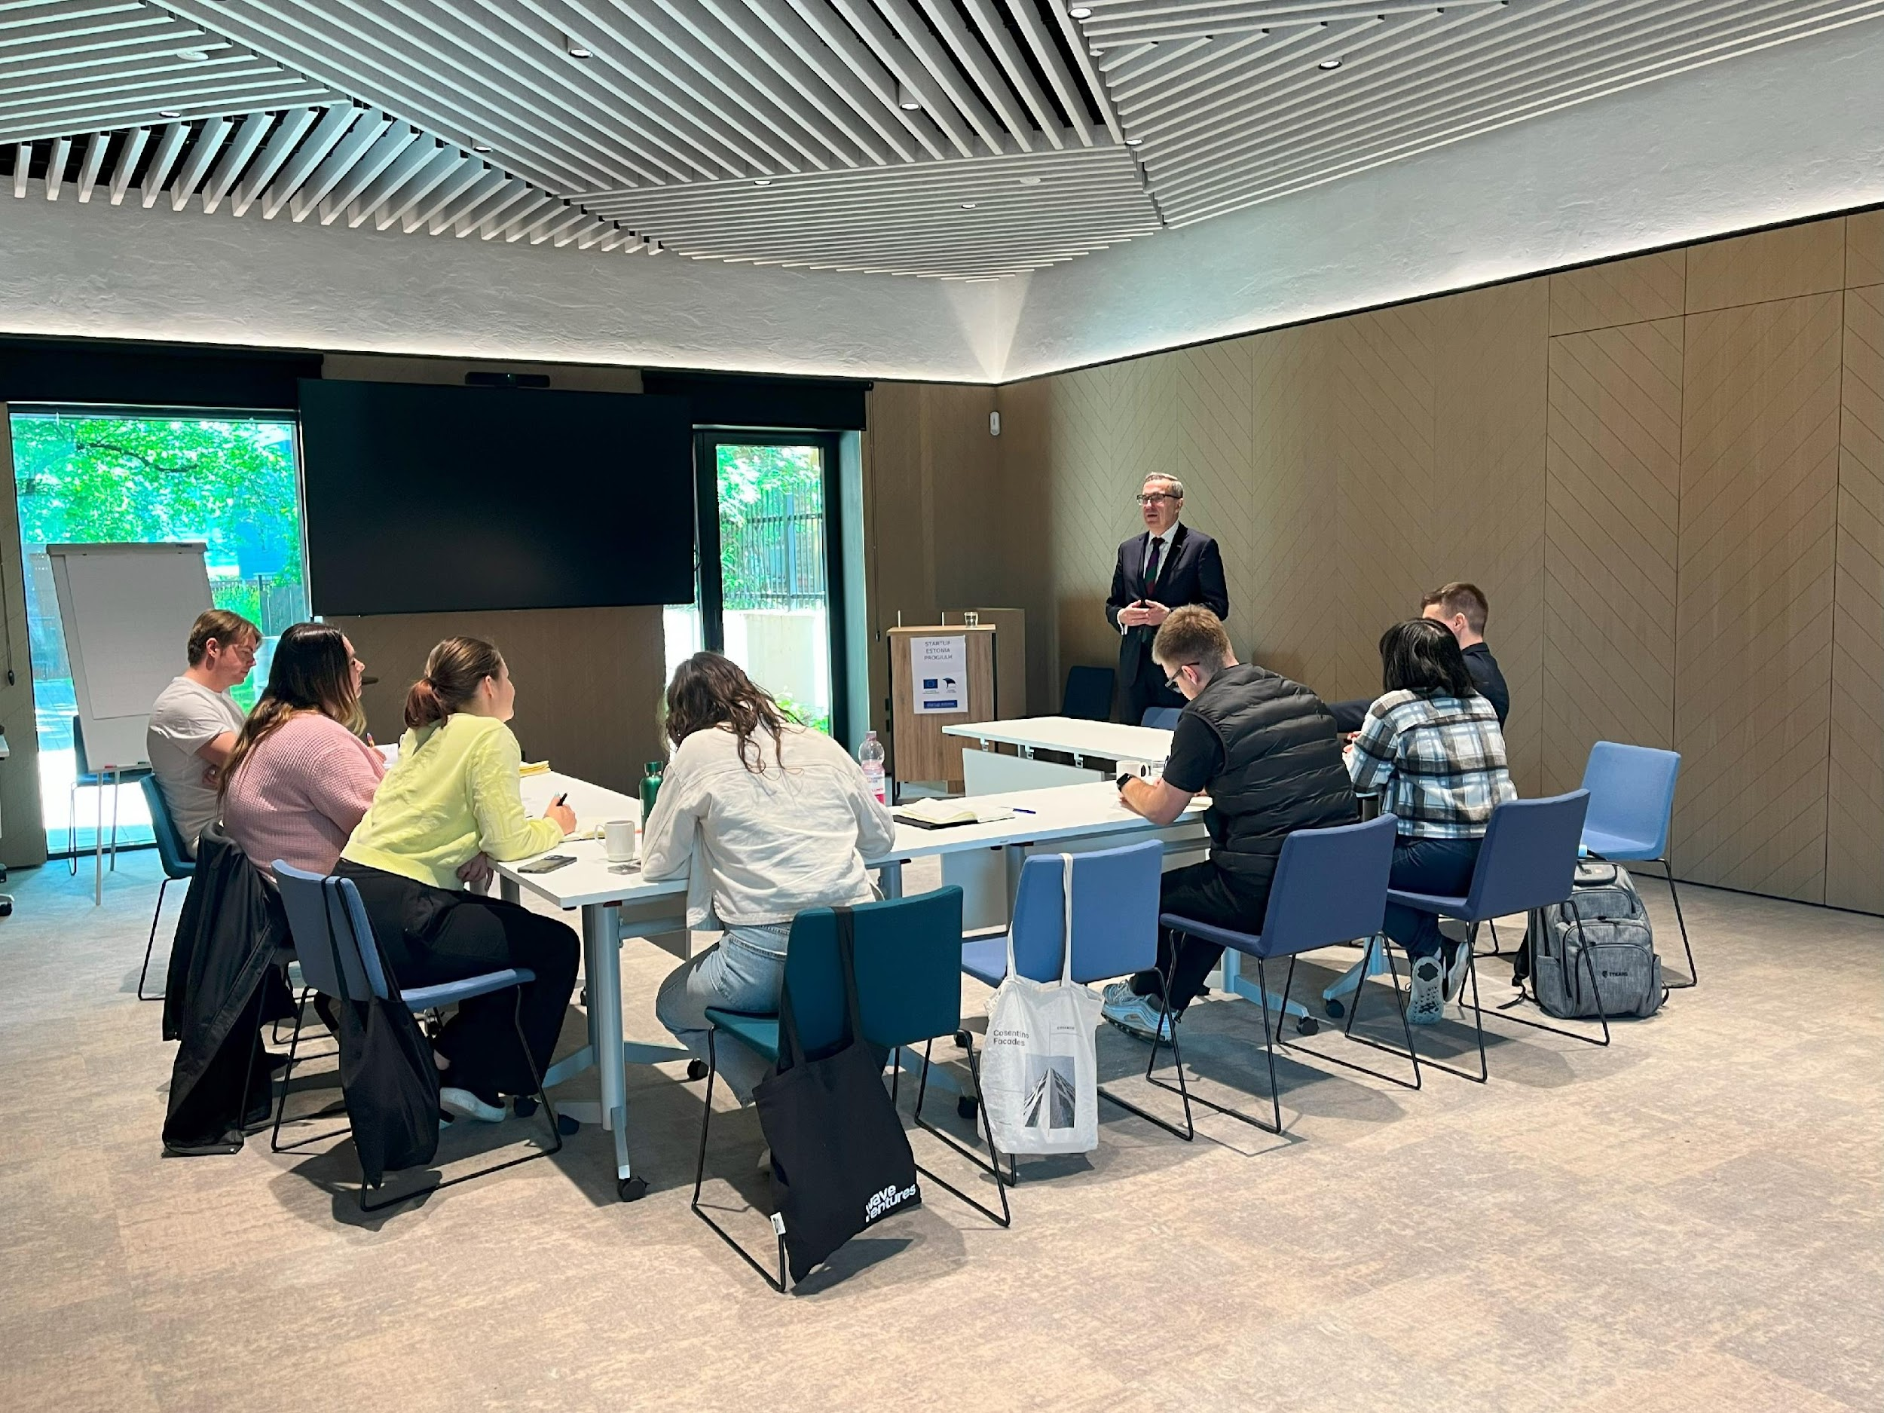
Mart Maasik’s session
Networking event with
London Business School
Andres Sutt’s session
Notes:
‹#›

Slide 13
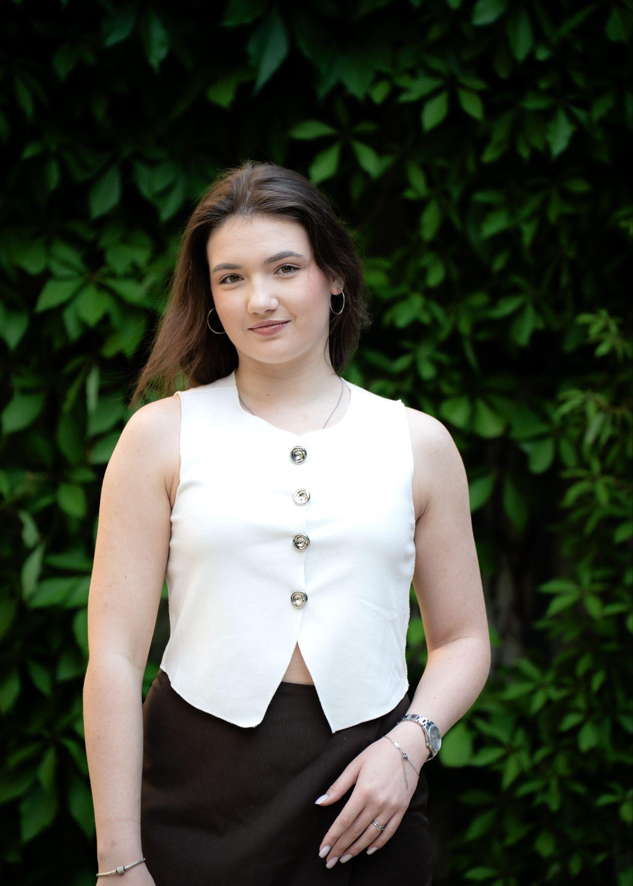
“MIMIR Fellows wasn’t just a program to me - it was a full-body crash course in how innovation actually works in Europe. The pre-readings grounded me, the sessions accelerated me, and the cohort helped me process it all in real time.
If the readings gave me the language of the startup world, the speakers gave me the accent.”
Fellow 2025
Notes:
‹#›

Slide 14
Impact
Alumni
Ecosystem
Speakers
You will make new meaningful connections with your peer Fellows and be part of the alumni. We will be keeping in contact with you and providing opportunities that we see fit for the group.
You will be part of the Estonian deep tech ecosystem as both universities and the Fellows brand itself are a testament to your accomplishments. You will have the tools to make an impact in the startup and deep tech ecosystem as you are equipped with a multidimensional view from all the different key players.
You will benefit from the first connections of over 30 speakers, giving you a warm introduction that you can use to create actual change in the world.

Slide 15
Other, less important gains
6 credits
Accommodation and food!
Upon completion of the program. This has to be pre-confirmed with us and your study consultant on how these can be integrated into your curricula.
Who does not like free food, right? We cover accommodation, breakfast and lunches for the duration of the bootcamp. But we expect excellence of you!

Slide 16
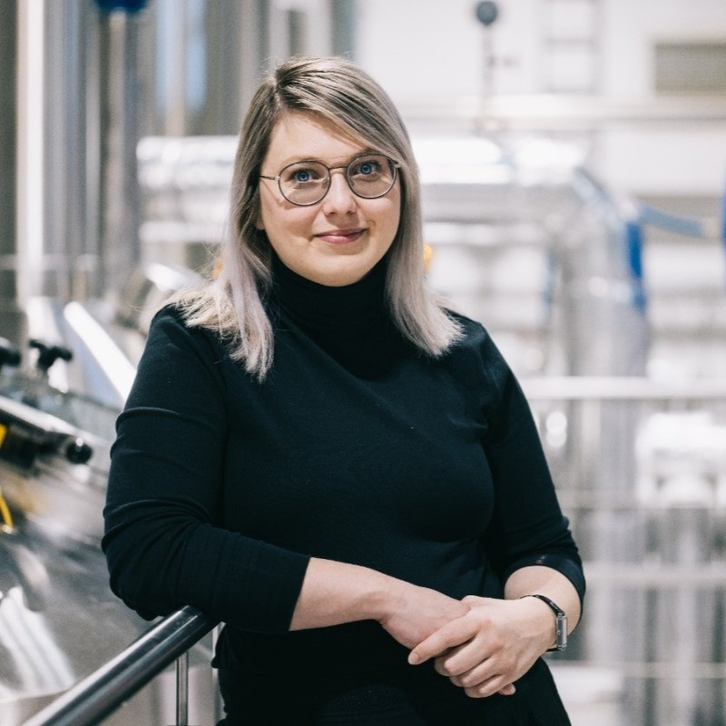
“Thank you so much! The first cohort consisted of amazing talent who have ambition and courage. Keep it going!”
Mary-Liis Kütt

Slide 17
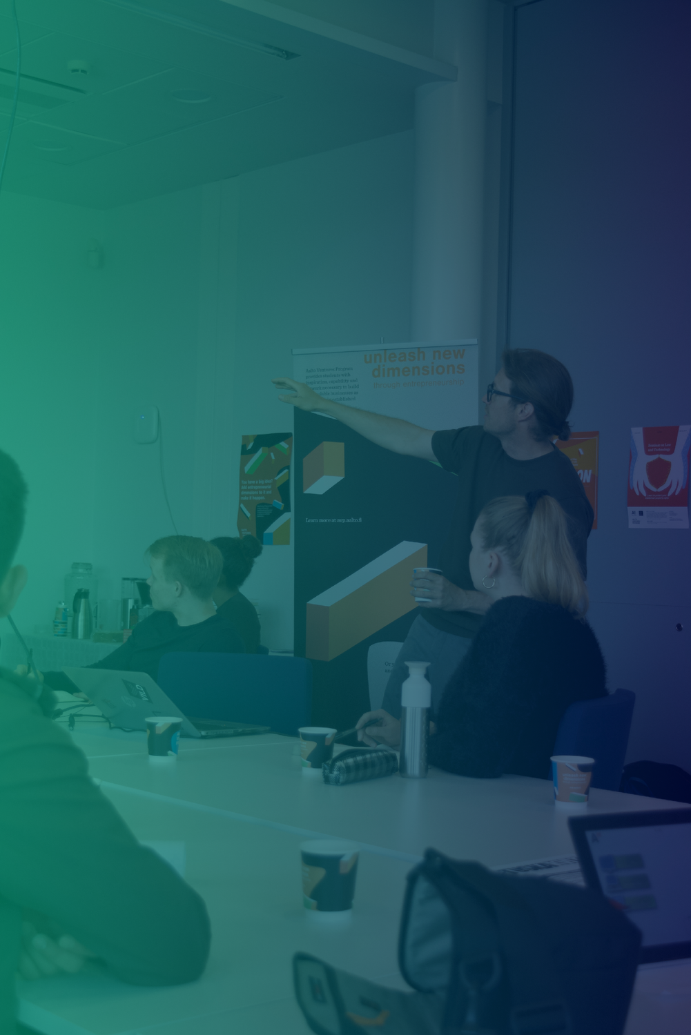
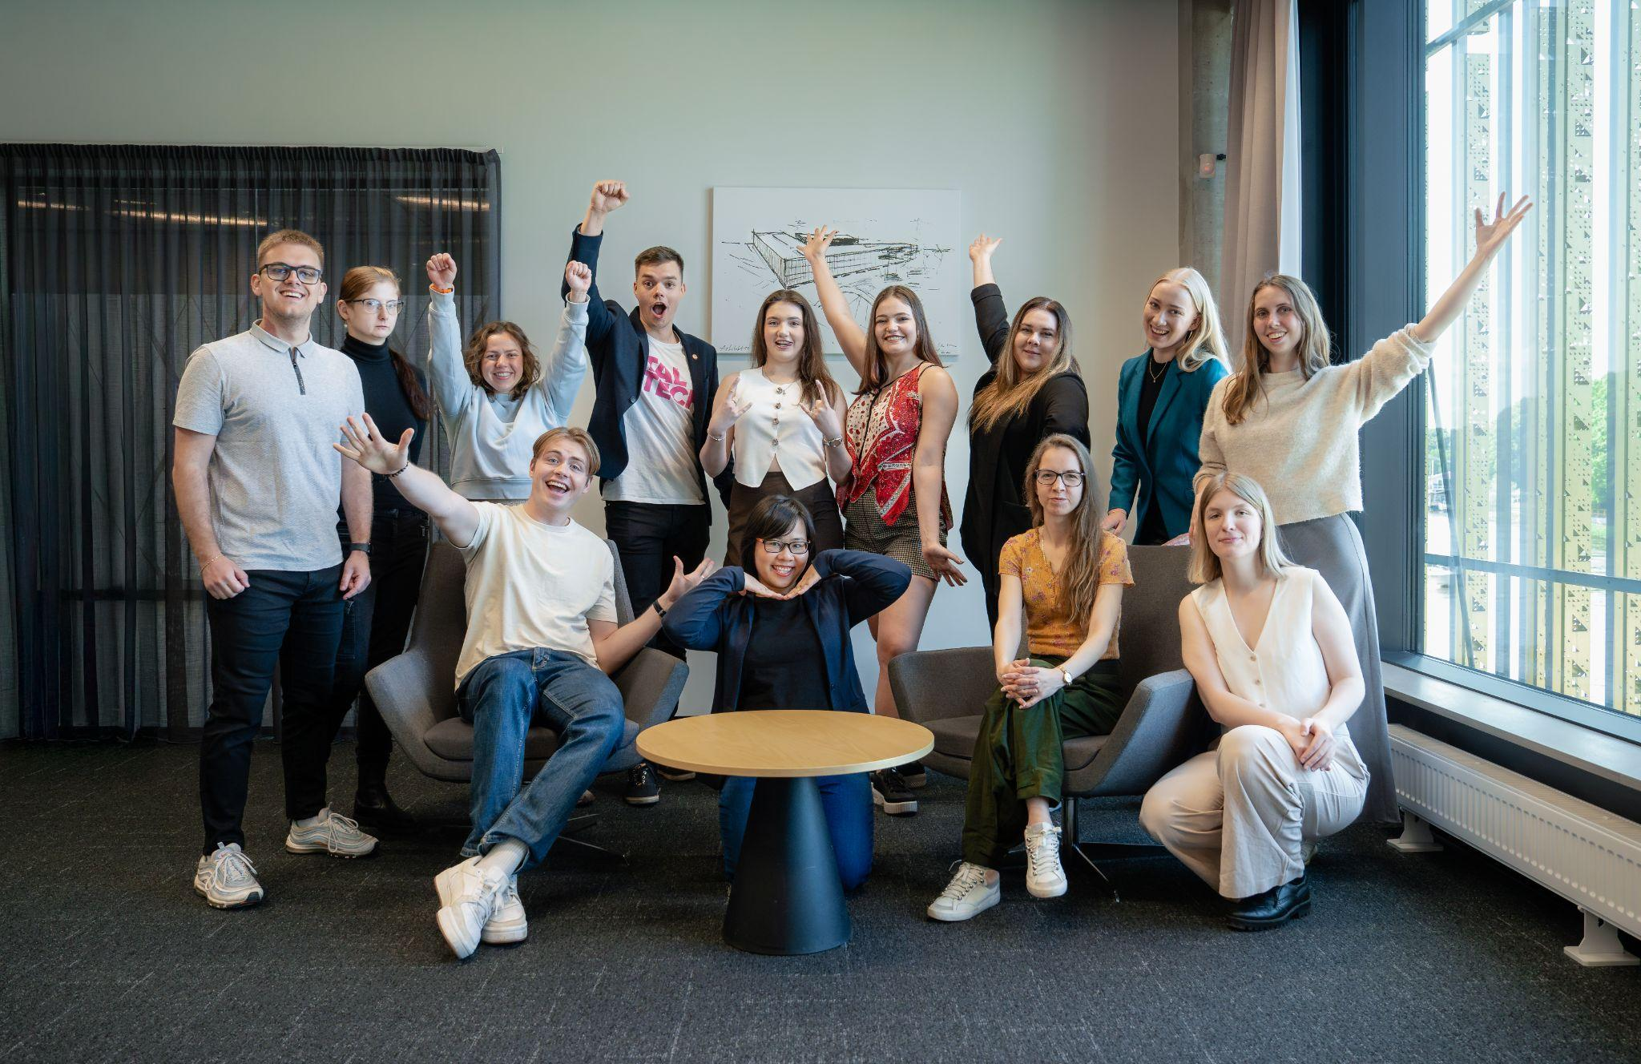
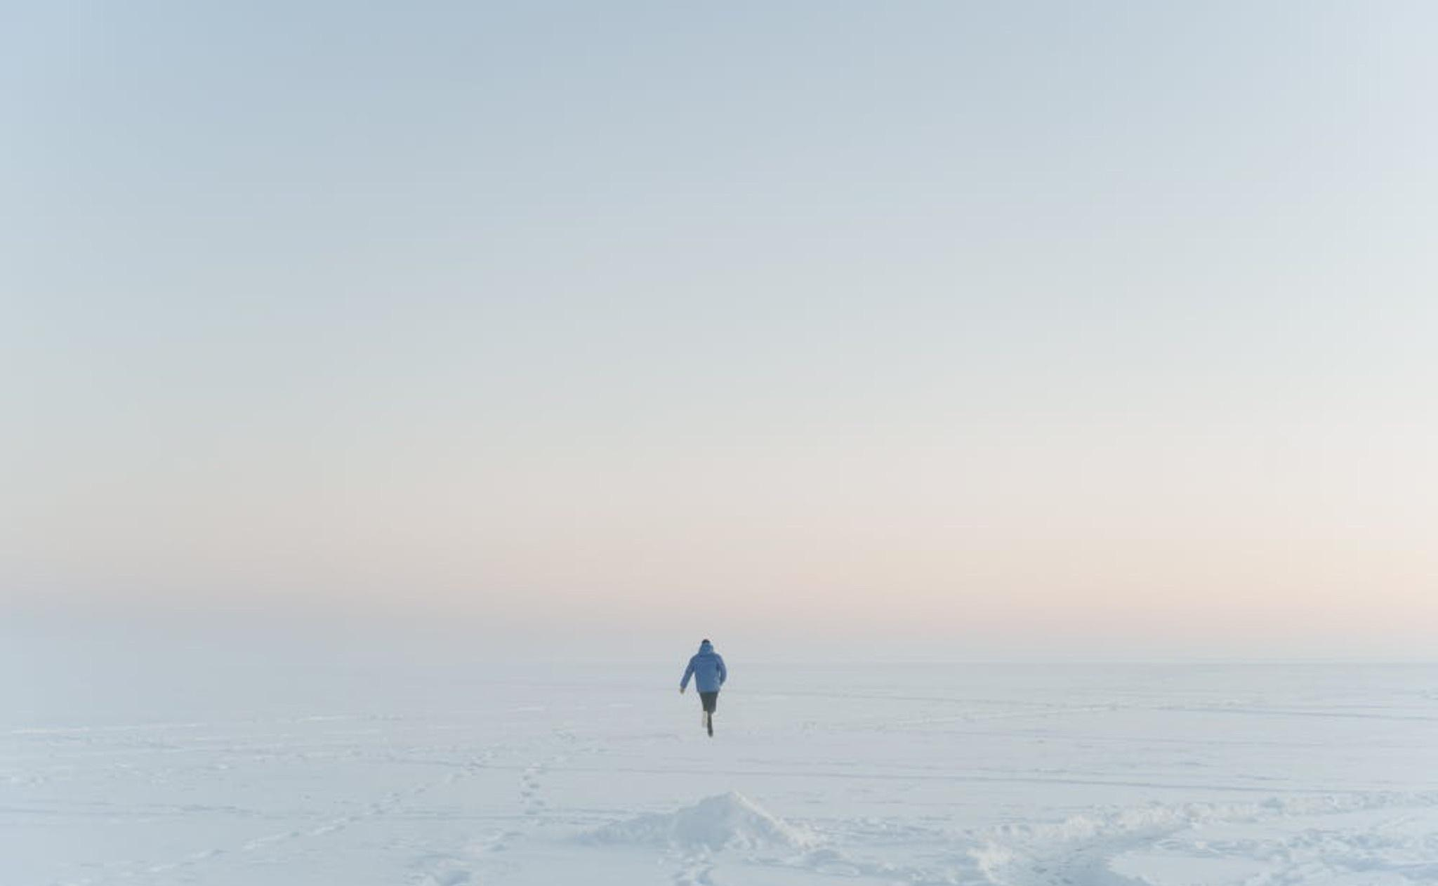
THE WORLD REALLY
NEEDS YOU!
THE FELLOWS APPROACH
THE PROGRAM COMBINES:
Pre-assignments, including readings and preparing questions for the speakers.
A bootcamp with around 40 guest lectures from both academia and industry around specific themes.
A paid summer internship at a venture-backed high-growth startup, venture capital fund or R2B project.
A final project with the purpose to plan and execute a trip around a key theme to a prominent startup hub.
READ MORE

