Slide 1
Novel Electrochemical Sensor for Point-of-Care Stress analysis
Preferred background of CEO/Business Developer:
point-of-care sensors, electrochemistry, stress

Slide 2
Opportunity and Conditions
TalTech’s annual budget for research and development (R&D) is about 50 million euros.
We turn research into market opportunities by creating science-based spinoffs and bringing together multidisciplinary teams.
We are currently seeking a CEO or Business Developer to join the team developing novel electrochemical sensor for point-of-care stress analysis.
What’s in it for you?
You will have the opportunity to join a newly formed spinoff based on years of cutting-edge research and receive equity ownership in the company. The cap table will be developed jointly with the research partners. TalTech will receive 5–10% equity at the founding stage in exchange for the IP.
What we expect from you?
A strong view on the best product–market fit for the technology
Your anticipated personal contribution, in terms of time and/or funding
The ability to attract financing, whether through personal investment, external investors, or grants
How to apply?
To apply for the position, please complete the presentation slides (you are welcome to add or modify them) and send them to mirjam.kert@taltech.ee .
If the team considers you a good fit for the CEO or Business Developer role, we will arrange a meeting to discuss the possibility of working together.

Slide 3
The Problem: Stress
1
Systematic stress exposure might have adverse effects on the overall cognitive and physical well-being. Hence, monitoring everyday stress is highly desired in personalized health care field. Personalized health care provides individuals with a personal health management plan to maximize their health and minimize disease.
Invasive methods like venipuncture blood sampling are, by default, associated with stress.
This is the reason saliva, sweat and urine gain increased attention as diagnostic fluids, due to their non-invasive sampling nature, ease of collection, and high compliance among diverse populations.
2
A multitude of biochemical, physiological, and psychological reactions are triggered by the human stress response. These reactions are governed by closely intertwined axes of the neuroendocrine system and their interaction with the human immune system.
Specifically, cortisol is the biomarker indicating the activity of hypothalamic-pituitary-adrenal axis and cellular/humoral immunity respectively in response to stress. BDNF is a stress-responsive neurobiological marker.

Slide 4
The Problem – Measuring Stress
1
Cortisol and BDNF are detectable in human and horse saliva, while cortisol is detectable also in sweat and urine. The most widely used methods in routine clinical laboratories are immunoassays and enzyme immunoassays (ELISA), luminescence and fluorescence assays as well as liquid chromatography tandem mass spectrometric assays (LC-MS/MS). These methods are expensive and performed in the laboratory.
2
Even though the price of a single test varies from €0.5–5 (the price is for the diagnostic company/hospital, not for the patient), multiple additional reagents must be purchased (e.g., calibration sets, plastic, vials, etc.).
However, the biggest issue with these assays is the price of the analyzer – the machine providing the assay read-out. Typically, prices of analyzers start at 150 000 € (for instance with a capacity of 60 samples and throughput of 100 tests per hour).
Currently, no commercial electrochemical Point-of-Care sensors measuring BDNF and/or cortisol from non-invasive biofluids are available.

Slide 5
The Solution: Electrochemical Sensors for Cortisol and BDNF detection
Selective recognition enabled by robust Molecularly Imprinted Polymer (MIP) receptors.
Detection of cortisol and BDNF in non-invasive samples.
True Point-of-Care testing solution.
Possibility of repeated cortisol measurements using the same MIP-sensor chip throughout the day.
Patent portfolio.

Slide 6
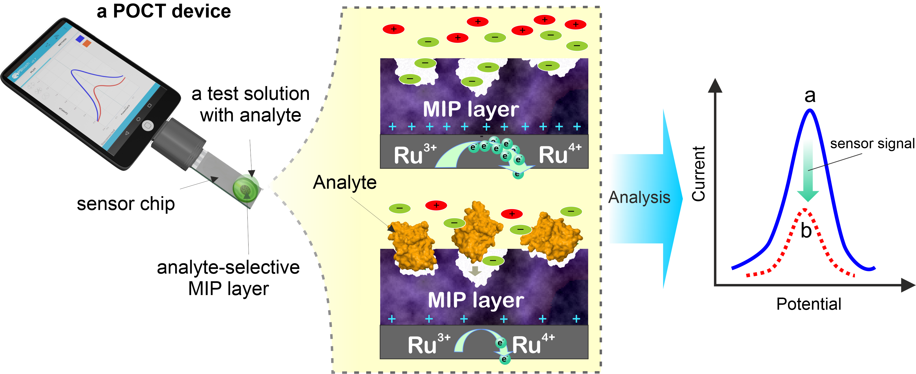
The Tech: Electrochemical Sensing using a MIP
a Molecularly Imprinted Polymer (MIP) is synthesized on an electrode surface.
The MIP contains recognition cavities that are complementary to the 3D structure of molecules of interest (analyte). These cavities selectively bind the analytes via a lock-and-key mechanism.
Binding of the analytes to the cavities causes a reduction in electrochemical activity of the system, which allows to quantify (measure) the concentration of the analyte.

Slide 7
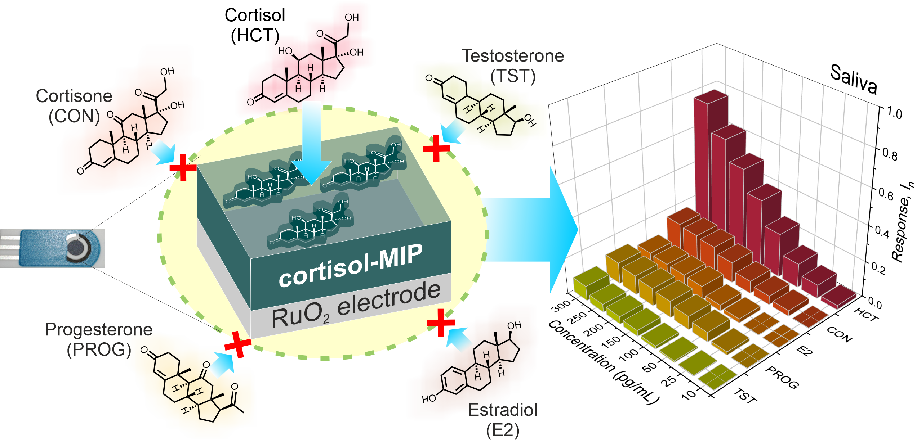
The Tech: Selectivity of MIP-based Sensor towards Cortisol

Slide 8
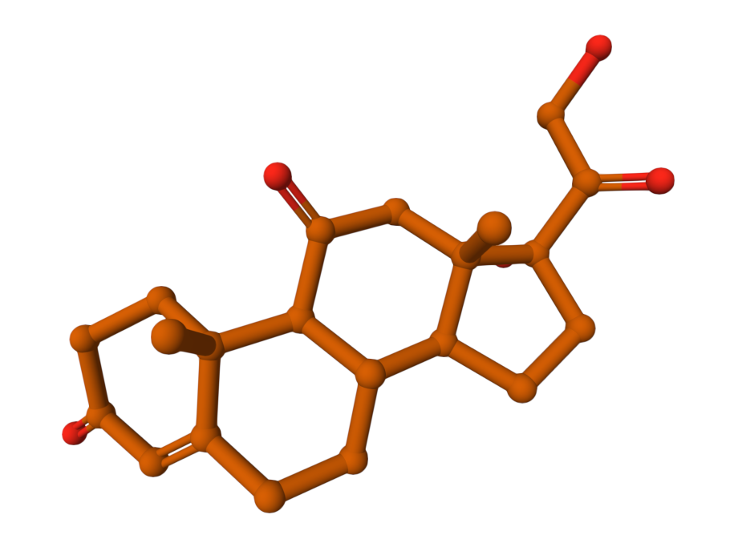
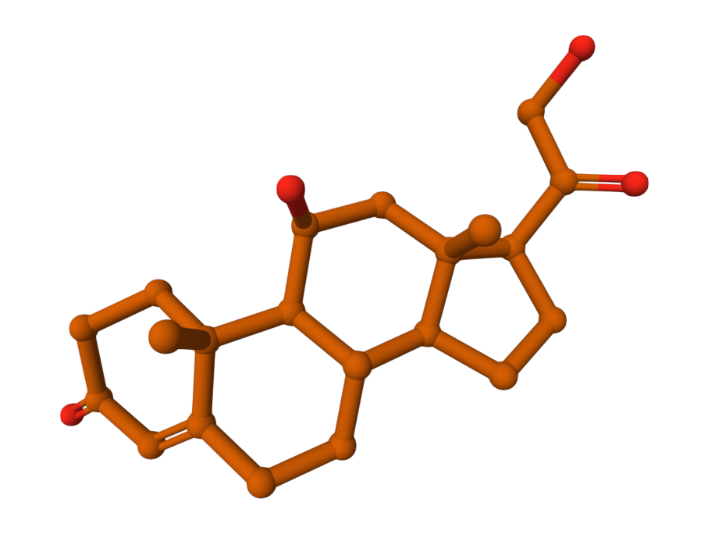
The Tech: Selectivity at a Molecular level towards Cortisol
*
*
versus
CON, cortisone
[PDB accession no: 8CC0]
HCT, hydrocortisone (cortisol)
[PDB accession no: 8CBY]

Slide 9
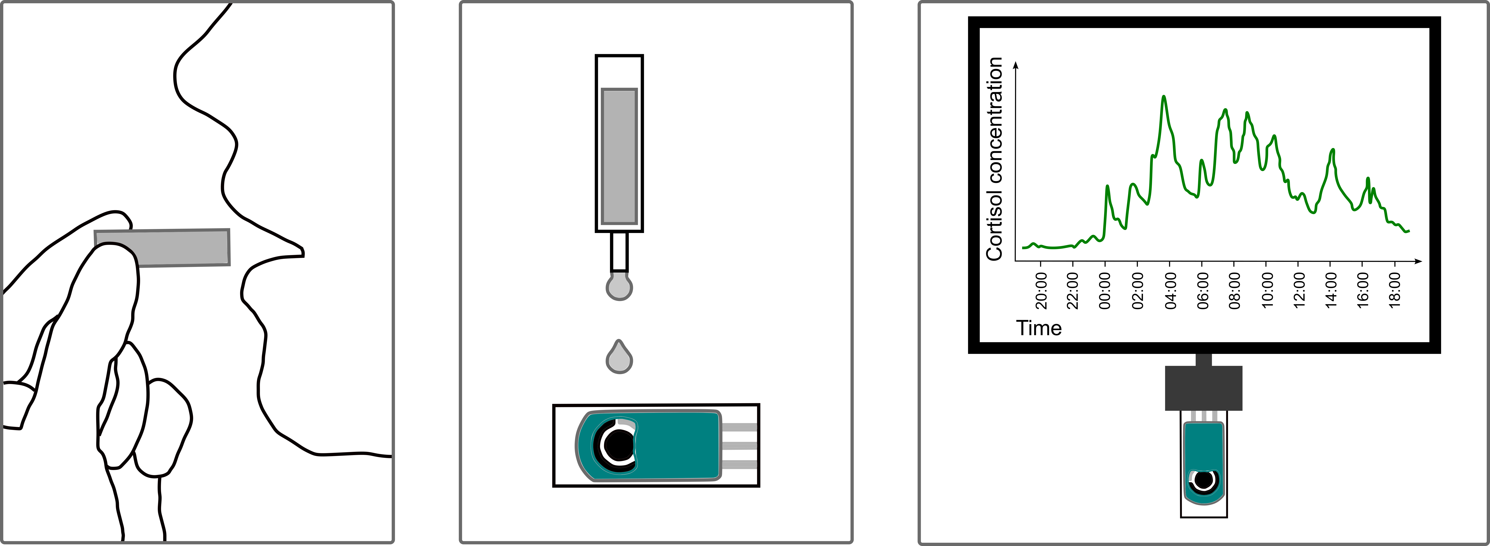
Use-case: Non-invasive Point-of-Care Detection of Cortisol
1. Collect saliva sample at home.
2. Apply saliva sample dropwise to Cortisol MIP-Sensor.
3. Get the pattern of your cortisol pulses on phone/tablet/computer.

Slide 10
MIP-based Cortisol Sensor: Current Stage
Input from TalTech
According to KTH Innovation Readiness Level™:
Technology Readiness Level (TRL) = 5:
Testing and validation of discrete technology components' combination in the intended environment – synergy of technology components (prototype) proven.
Intellectual Property Readiness Level (IPRL) = 7:
1x Estonian patent (EE)
1x United States patent (US)
1x European patent application (EP)
1x Patent Cooperation Treaty (PCT) international application

Slide 11
Market Opportunity
Input from TalTech
Market #1: Cortisol assay for Cushing syndrome (CS) & Addison’s disease (AD patients.
Annual market size for patients with CS and AD is
multiple of 4-16M €
Market #2: Equine cortisol assay (veterinary diagnostics).
Annual cortisol testing will be required for approximately 1 million thoroughbreds and hence, the annual market size is
19-69 M€
Market #3: Stress.
For instance, even if the uptake of cortisol test is 1% among the high performers, then the potential market size can be estimated as
55-200 M€ per a single usage of the test

Slide 12
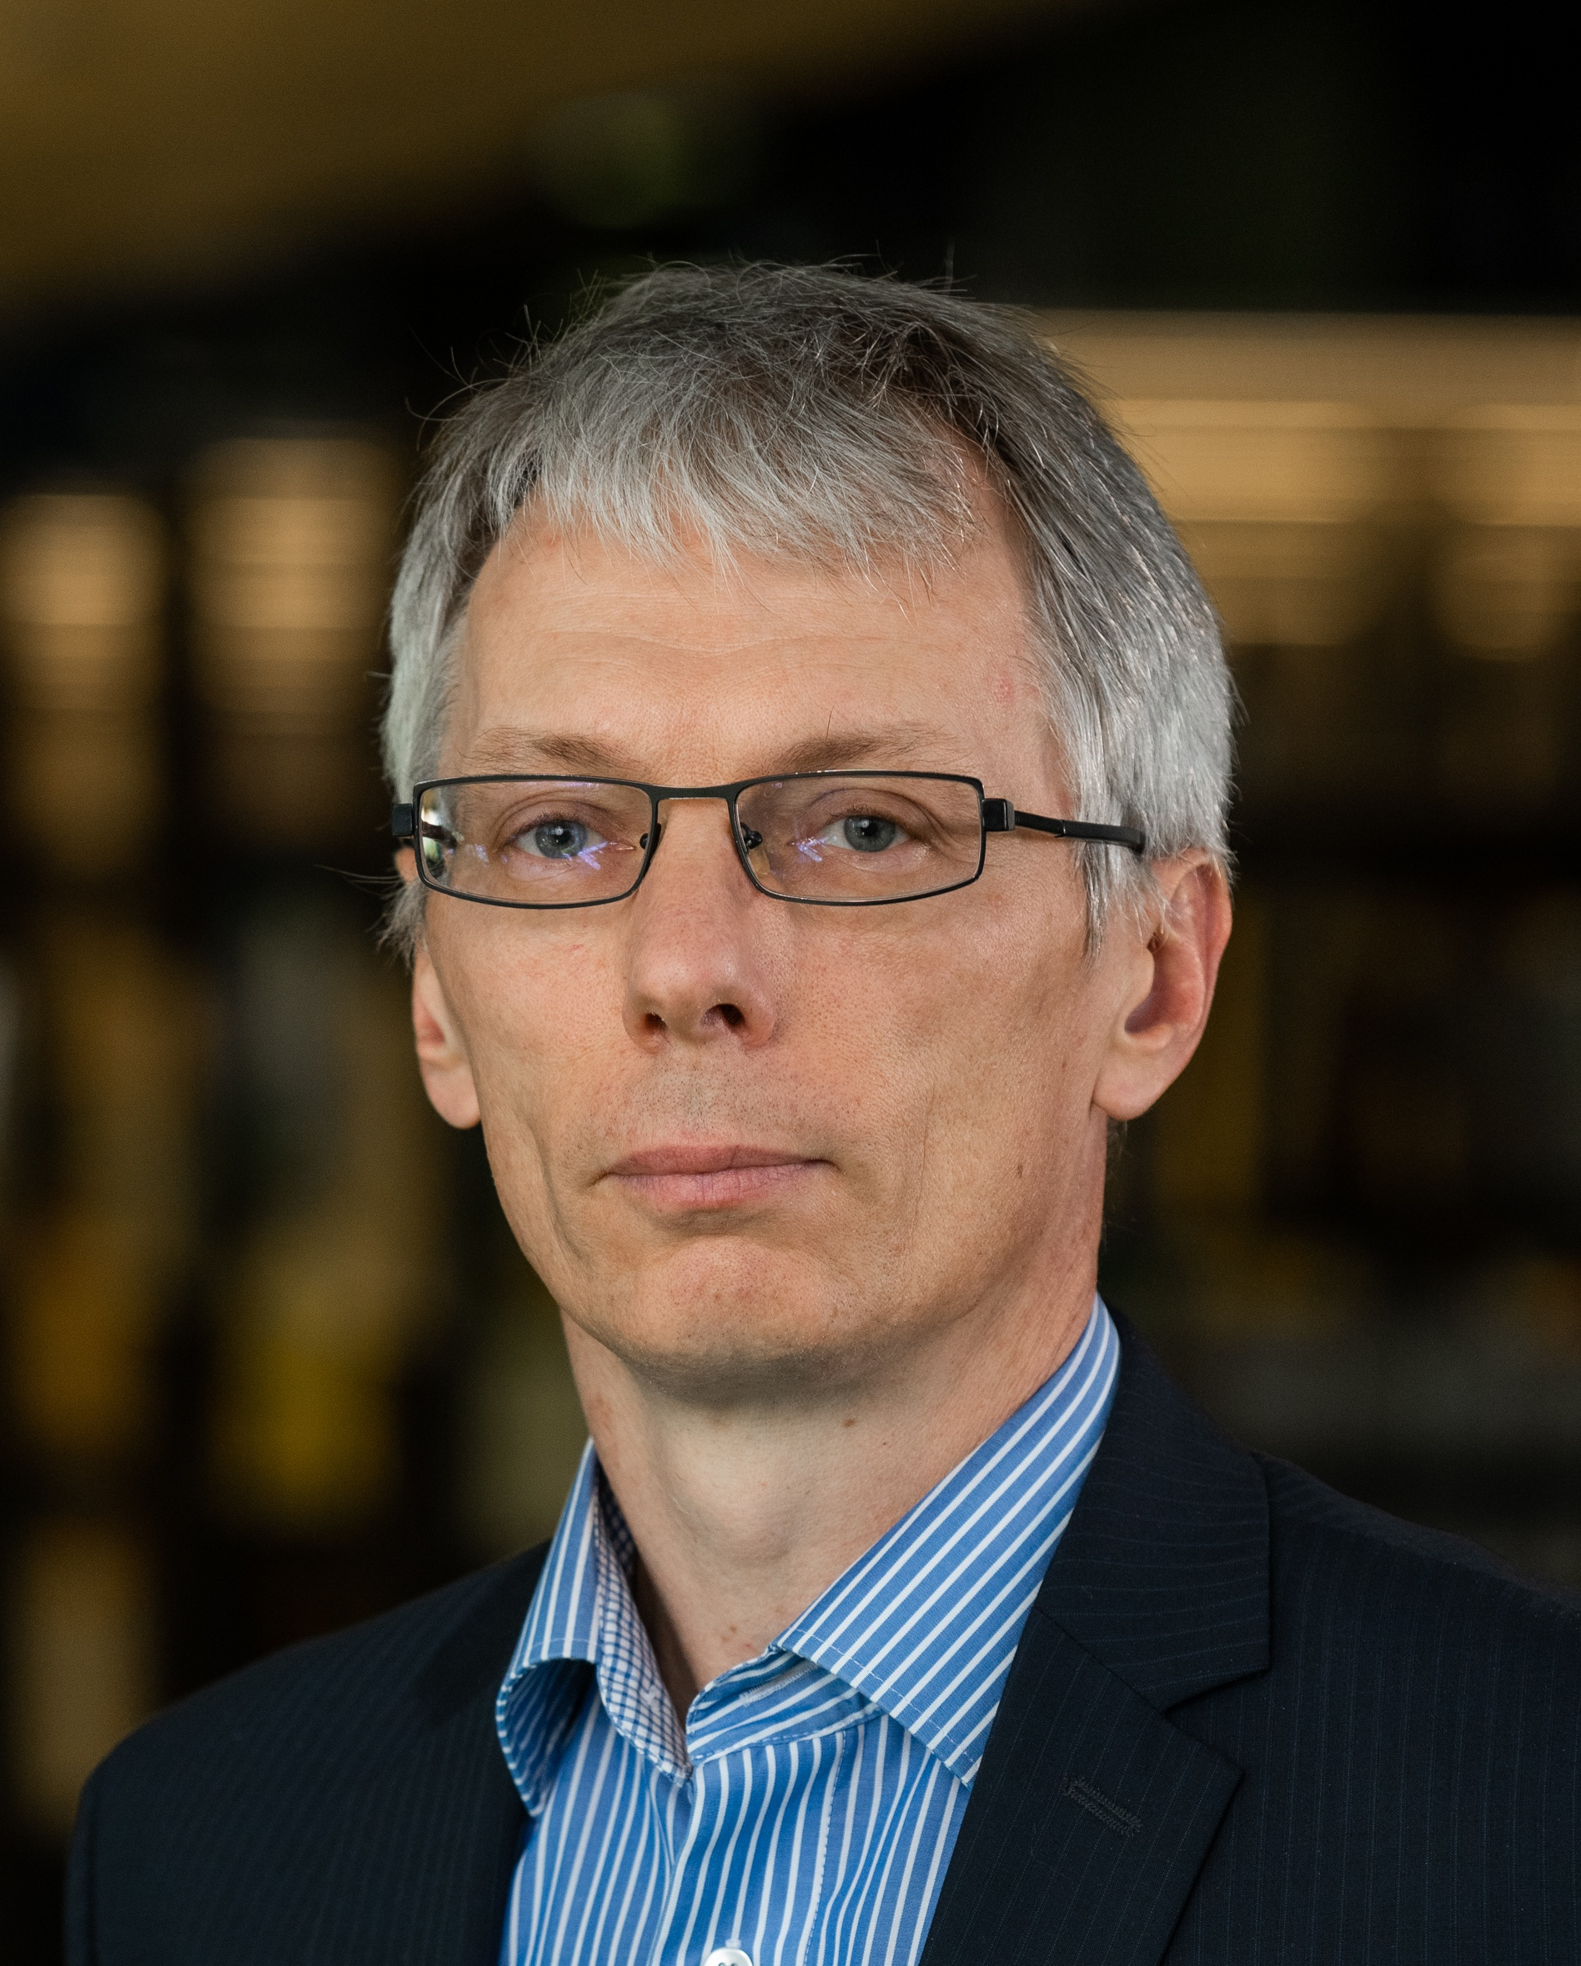
Team
Members of the Biofunctional Materials Lab at TalTech, led by Lead Research Scientist:
Dr. Vitali Syritski
https://www.etis.ee/CV/Vitali_Syritski/eng/
Over 20 years of expertise in molecularly imprinted polymers (MIPs), with a strong track record in designing stable, selective, and cost-effective synthetic recognition materials.

Slide 13

Market Opportunity (TAM, SAM, SOM)
Input from CEO/Business Developer
Please type here…

Slide 14
Commercialization plan: prototype -> product
Input from CEO/Business Developer
Please type here…

Slide 15
Financial projections: spinoff value maximization
Input from CEO/Business Developer
Please type here…

Slide 16
Vision for future team
Input from CEO/Business Developer
Please type here…

Slide 17
Contribution
Input from CEO/Business Developer
Please specify: I would like to join the team as CEO/Business Developer/ ...
Please specify: My contribution can be (e.g., time, money, competencies, contacts, …) …
Please specify: My expectations regarding equity ownership in the spinoff founding stage is in the range X – Y %

