Slide 1
CelluMotion
TalTech is looking for a CEO and co-founder for a new potential startup
Preferred background of the CEO: business development in the field of materials commercialization.
Plant-based advanced materials

Slide 2
PROBLEM:
Absence of bio-based functional coatings with tunable performance
There is a strong market need for protective and functional coatings or membranes, yet current solutions are mostly:
Fossil-based
Difficult to tailor permeability
Environmentally persistent
SOLUTION:
CelluMotion provides:
Hydrophobic, protective coatings or membranes
Tunable permeability (e.g. moisture, gas, vapor)
Based on cellulose and plant oils, not petrochemicals.

Slide 3
PROBLEM:
Dependence on global, non-local raw materials
Many advanced materials rely on:
Imported fossil feedstocks
Complex, centralized production
SOLUTION:
CelluMotion addresses this by enabling:
Local production (Estonia)
From locally available cellulose and rapeseed oil
Supporting supply-chain resilience and regional autonomy.

Slide 4
PROBLEM:
Slow and capital-intensive production of bio-based plastics
Traditional bio-based plastics often require:
Multi-step chemical synthesis
Large-scale centralized plants
SOLUTION:
CelluMotion solves this through reactive extrusion, enabling:
Faster production
Small-scale or modular manufacturing
Rapid iteration of material properties

Slide 5
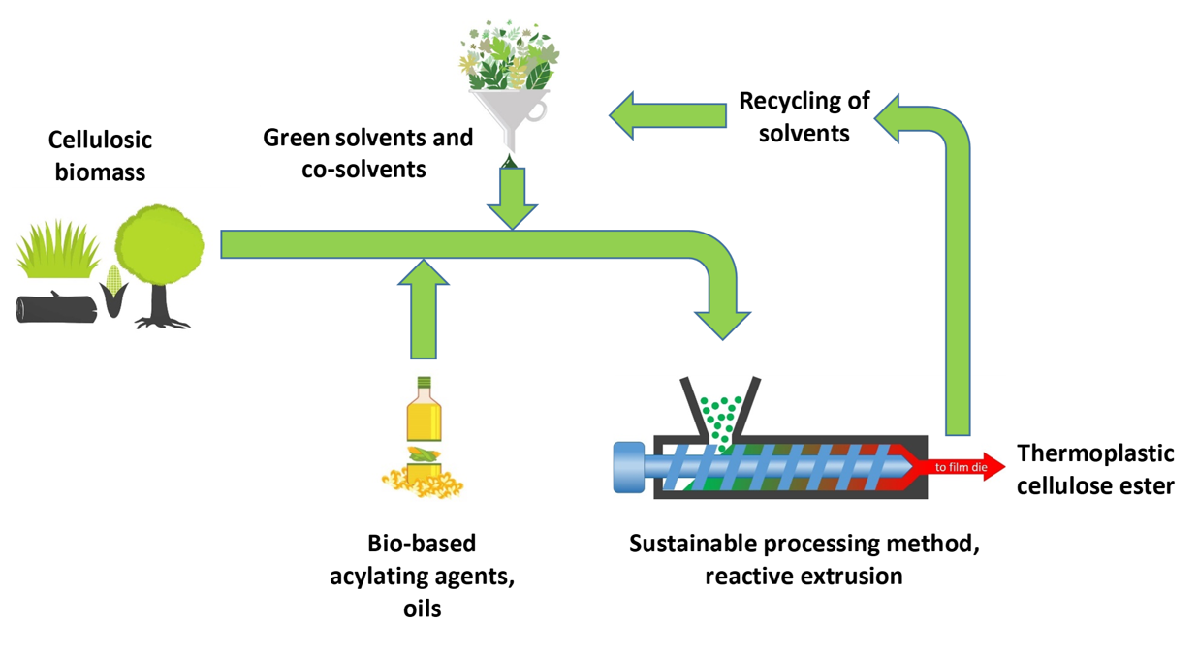
TECHNOLOGY

Slide 6
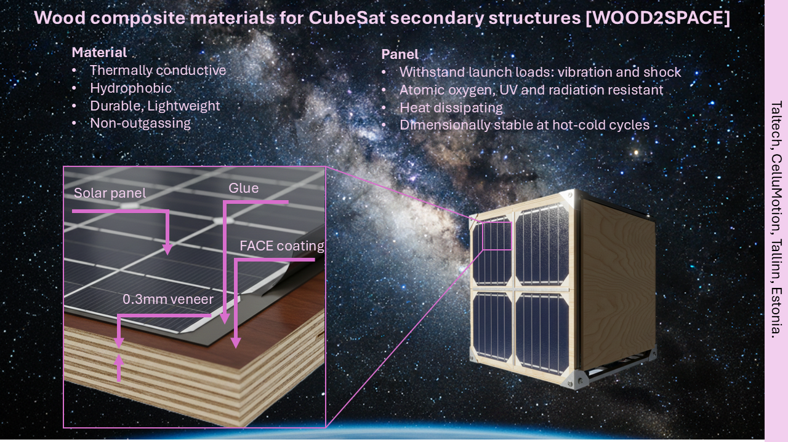
APPLICATION:
ON-GOING PROJECT
Space & Aerospace Applications: WOOD2SPACE, ESA De-Risc
Secondary space structures
Lightweight panels, covers, and non-load-bearing structural elements using bio-based composite or coated materials.
Protective surface coatings
Hydrophobic and protective layers for components exposed to space environment.
Interior spacecraft components
Low-outgassing coated surfaces for cabins, lockers, or equipment housings (after validation).
Technology demonstrators
In-orbit testing of bio-based materials and coatings to validate durability, stability, and performance in space conditions.

Slide 7
MARKET OPPORTUNITY FOR SPACE APPLICATION [WOOD2SPACE]
Addressable Market (Baseline: 2023 launches)
Satellite launches (2023):
~130 × 1U CubeSats
~180 × 3U CubeSats
~80 × 6U CubeSats
Side-panel cost per 1U CubeSat (4 panels):
FR4-based PCB: €2,826
Aluminium-based PCB: €3,439
Relative panel demand:
3U CubeSat ≈ 3.5× 1U
6U CubeSat ≈ 5.25× 1U
Total Addressable Market (PCBs for side panels only)
FR4-based PCB TAM (2023):
≈ €3.33 million
Aluminium-based PCB TAM (2023):
≈ €4.06 million
Even a conservative niche in CubeSat side-panel materials represents a multi-million-euro annual market—and a strong credibility platform for broader CelluMotion commercialization.

Slide 8
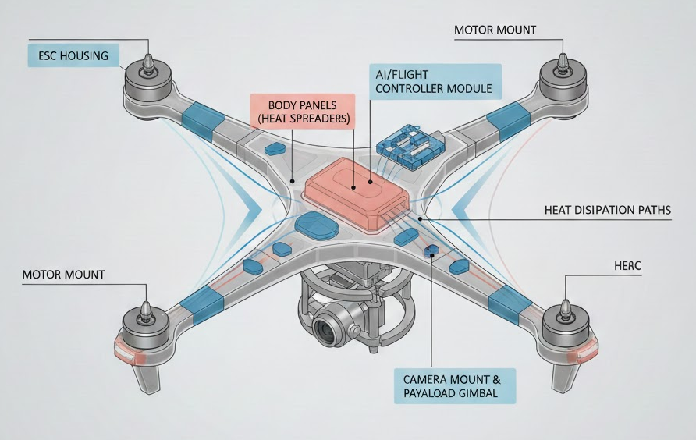
APPLICATION:
HEAT DISSIPATIVE BIO-PLASTICS/PROTECTIVE SURFACE COATINGS FOR DRONES
Casings, wings, and other plastic parts, heat-dissipation coating
Hydrophobic and protective layers for components
Drone Subsystem | Composite Role | Key Benefit
ESC housing | Heat spreader + enclosure | Lower hotspot temperature
Battery enclosure | Thermal buffer | Safety & lifespan
Body panels | Passive heat sink | Cooling
Camera mount | Thermal stabilizer | Image quality
AI module housing | Heat spreader | Prevent throttling
Wing skins | Solar + electronic heat dissipation | Endurance
Motor mounts | Secondary heat path | Reliability
Thermal inserts | Local heat spreading | Weight efficiency

Slide 9
MARKET OPPORTUNITY FOR
HEAT DISSIPATIVE BIO-PLASTICS/PROTECTIVE SURFACE COATINGS FOR DRONES
Assumptions
Global drone shipments (all classes): ~15-20 million units/year
Commercial + industrial drones: ~3-5 million units/year
Defense & high-end UAVs: ~100k-300k units/year
Thermally functional composite per part: $2-$40, depending on application
This slide was prepared with help of
ChatGPT TalTech EDU
Application | Typical Part Value (USD) | Addressable Units/Year | Estimated TAM (USD/year)
ESC housing | $3-8 | 6-10M ESCs | $20-70M
Battery enclosure | $8-25 | 2-4M drones | $25-80M
Body panels | $10-30 | 1-3M drones | $20-90M
Camera mount | $5-15 | 1-2M payload drones | $10-30M
AI module housing | $15-40 | 0.5-1.5M drones | $15-50M
Wing skins (fixed-wing UAVs) | $30-100 | 200k-500k UAVs | $10-40M
Motor mounts | $3-10 | 8-16M motors | $25-100M
Thermal inserts (modular) | $2-6 | 5-10M units | $10-40M

Slide 10
OTHER APPLICATIONS:
Protective & Functional Coatings
Hydrophobic protective coatings
Barrier coatings with tunable permeability (water vapor, gases, oils)
2. Membranes
Breathable membranes for construction materials, packaging, etc.
Controlled-permeability membranes for filtration, separation layers, agricultural applications, etc.
3. Packaging
Bio-based barrier coatings for dry and semi-dry goods packaging
4. Construction & Building Materials
Protective coatings for wood panels and boards
Moisture-regulating surface layers
Lightweight, coated cellulose-based panels
5. Automotive & Mobility (Non-structural)
Interior surface coatings
Low-VOC protective layers
6. Casings
Antistatic coatings for electronics

Slide 11
CURRENT STATE
Commercializing TalTech IP:
A REACTIVE EXTRUSION LINE AND METHOD FOR MANUFACTURING THERMOPLASTICS FROM CELLULOSE
Priority number: P202300008
CELLULOSE ACYL GLYCOLATES AND METHOD FOR PRODUCING SAME
Priority number: EP24166644.5
On-going TemTa projects:
TemTa: New biomaterials made by reactive extrusion from cellulose and by-products of vegetable oil production (Link)
ESA De-Risk: Wood composite materials for CubeSat secondary structure(s) [WOOD2SPACE]

Slide 12


Team
Current Team
Illia Krasnou
Seniour researcher
https://www.etis.ee/CV/Illia_Krasnou/eng/
Illia.Krasnou@taltech.ee
+37258389514
Viktoria Gudkova
Development manager
https://www.etis.ee/CV/Viktoria_Gudkova/eng/
Viktoria.Gudkova@taltech.ee
+37256260175
Future potential team competencies and background
In addition to current team:
Business development and sales in advanced materials
Strong contacts base with market actors
Technology transfer from pilot-line to industry scale

